Slide 1
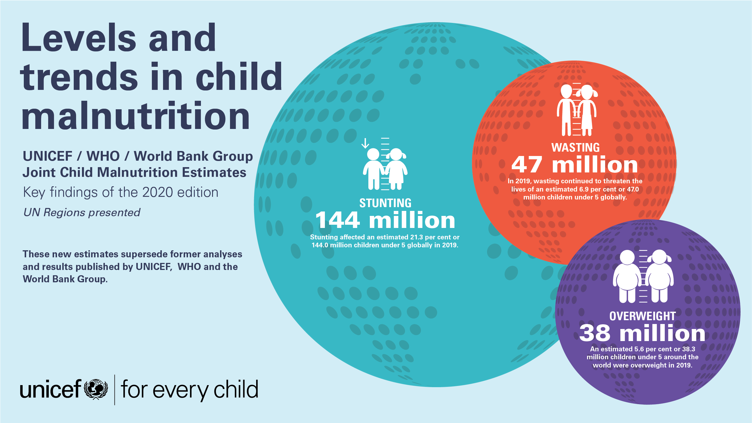

Slide 2
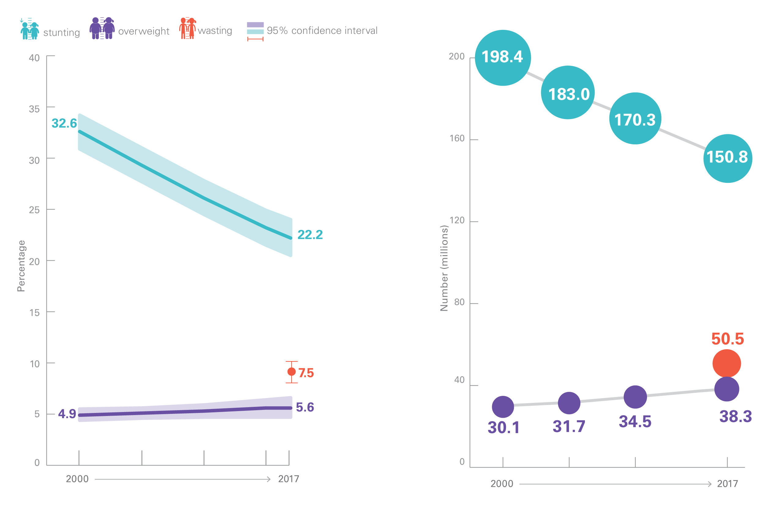
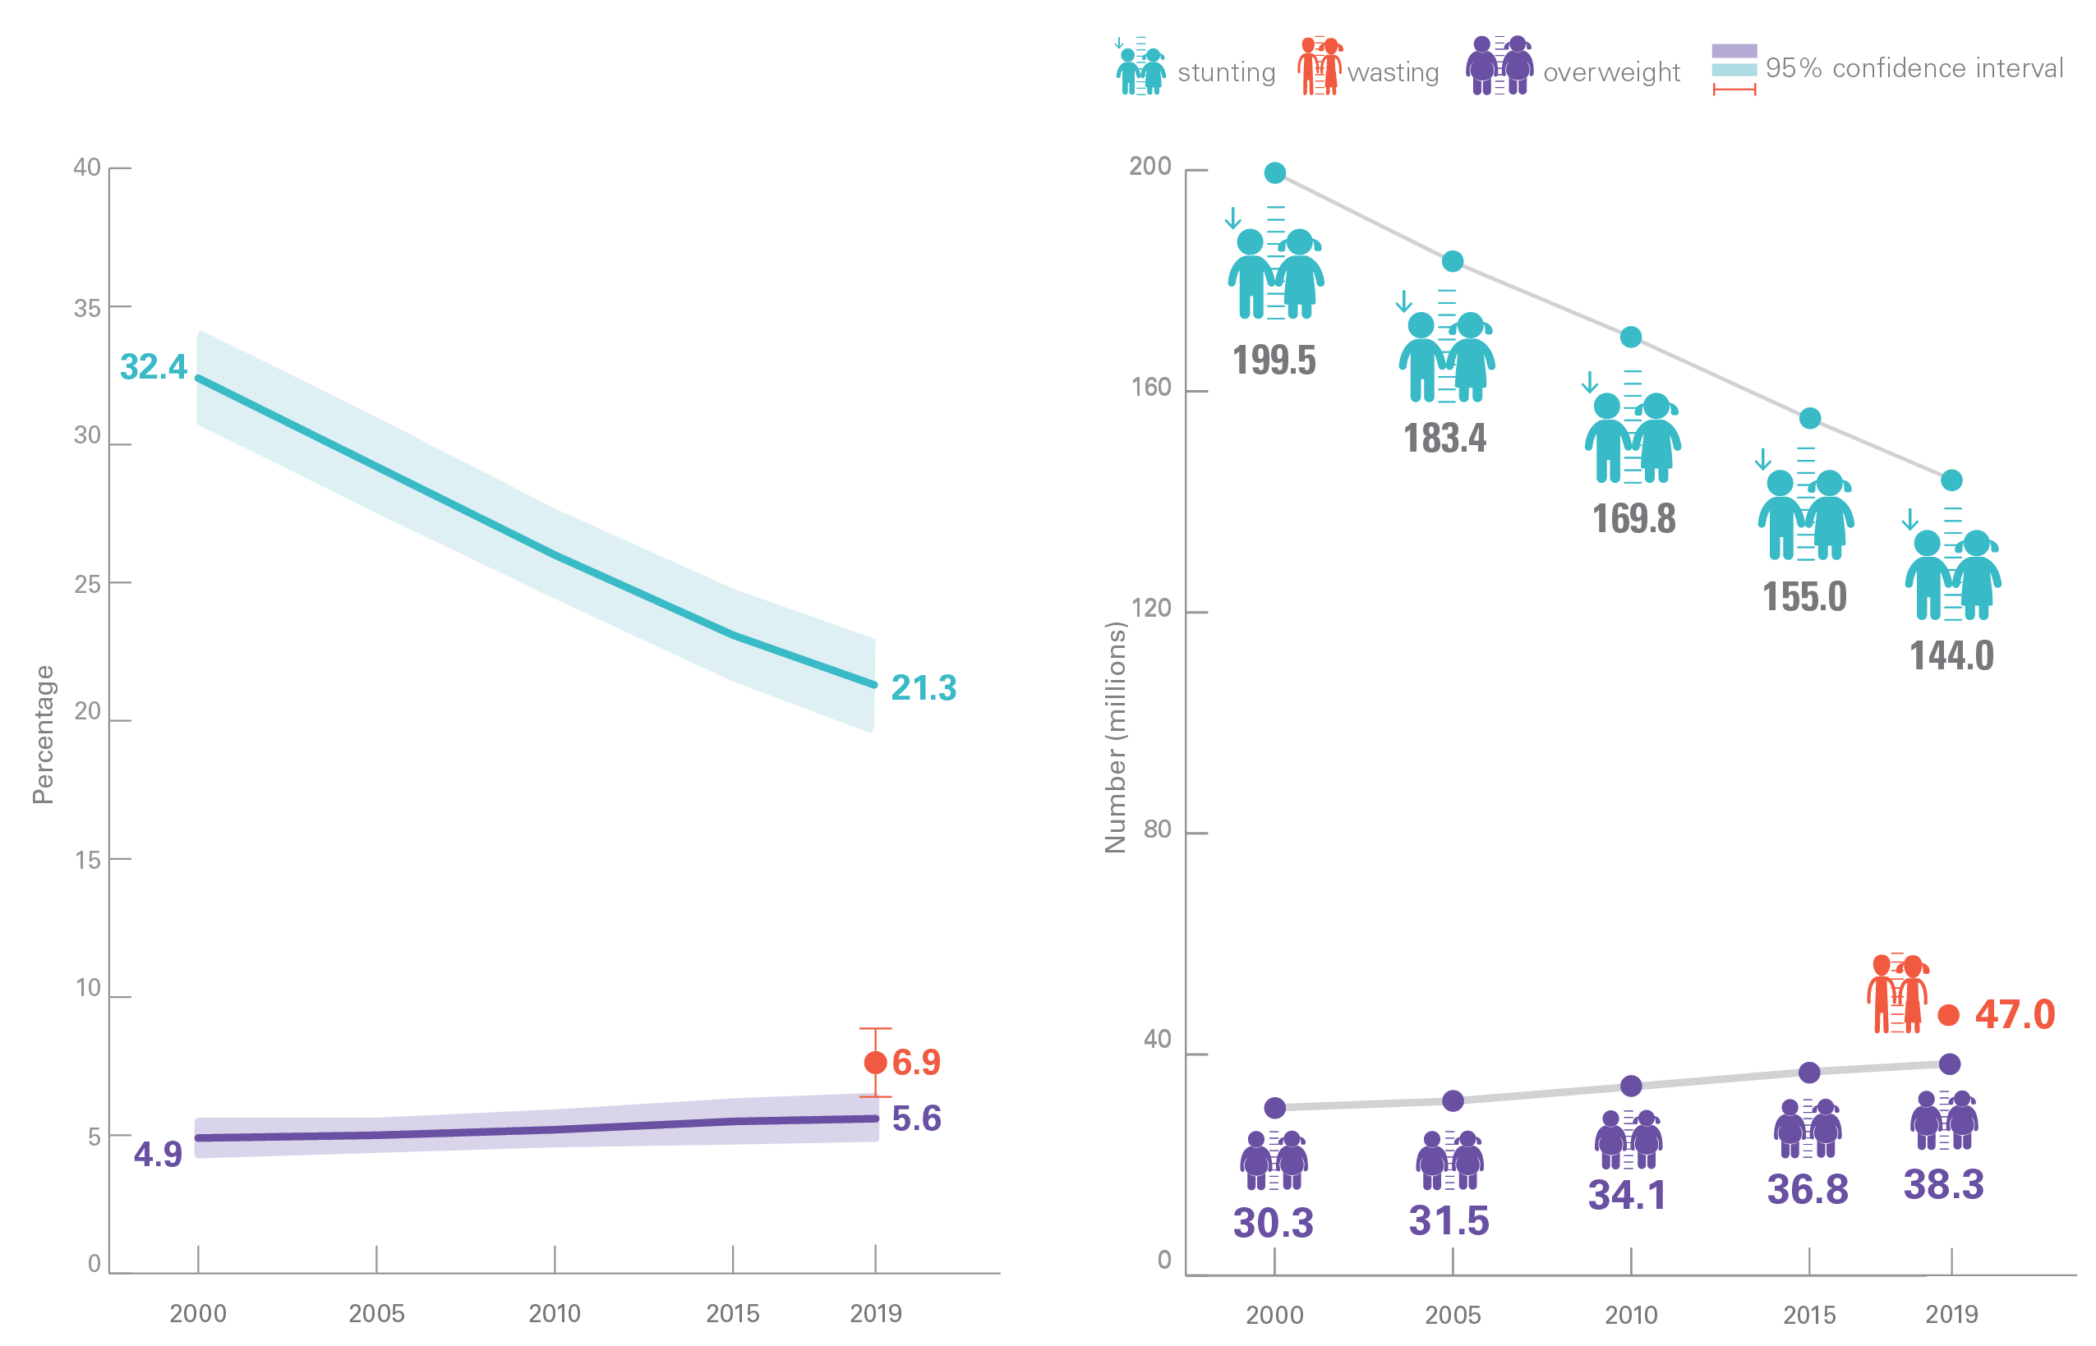
GLOBAL OVERVIEW
Prevalence and Numbers affected
Malnutrition rates remain alarming: stunting is declining too slowly while wasting still impacts the lives of far too many young children
Percentage of stunted, wasted and overweight children under 5, global, 2000–2019
Number (millions) of stunted, wasted and overweight children under 5, global, 2000–2019
Source: UNICEF, WHO, World Bank Group Joint Child Malnutrition Estimates, 2020 edition.
See Notes on the Data section on why only one time point is presented for wasting on the graphs above.

Slide 3
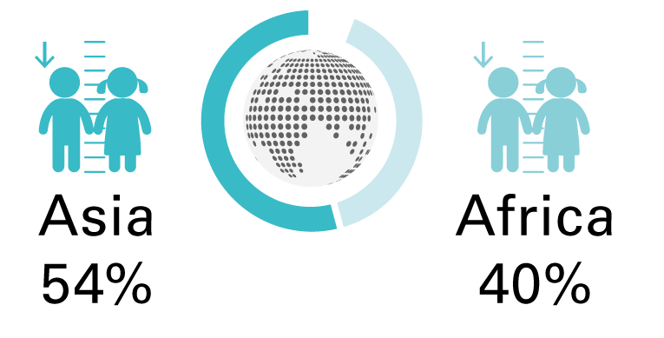
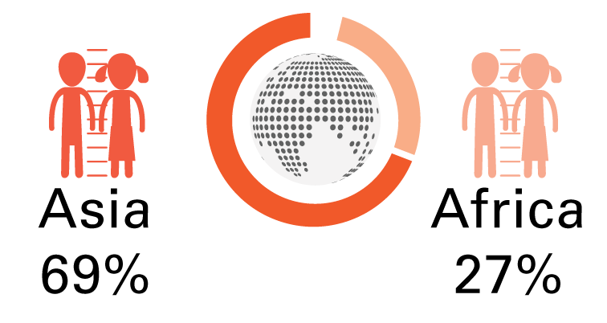
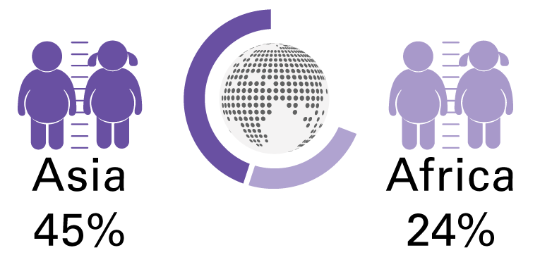
GLOBAL OVERVIEW
Africa and Asia bear the greatest share of all forms of malnutrition
In 2019, more than half of all stunted children under 5 lived in Asia and two out of five lived in Africa.
.
In 2019, more than two thirds of all wasted children under 5 lived in Asia and more than one quarter lived in Africa.
In 2019, almost half of all overweight children under 5 lived in Asia and one quarter lived in Africa.

Slide 4
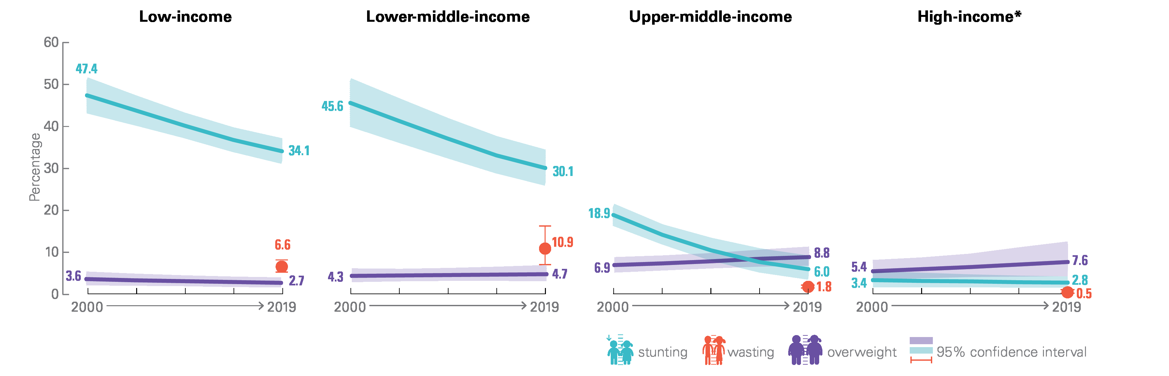
GLOBAL OVERVIEW
Income Classification
Percentage of stunted, overweight and wasted children under 5, by country income classification, 2000 – 2019
Source: UNICEF, WHO, World Bank Group Joint Child Malnutrition Estimates, 2020 edition. Note: *High-income countries: low (<50 per cent) population coverage in all time periods for overweight and wasting, and consecutive low population coverage in 2000 for stunting; interpret with caution.

Slide 5

Stunting refers to a child who is too short for his or her age. These children can suffer severe irreversible physical and cognitive damage that accompanies stunted growth. The devastating effects of stunting can last a lifetime and even affect the next generation.

Slide 6
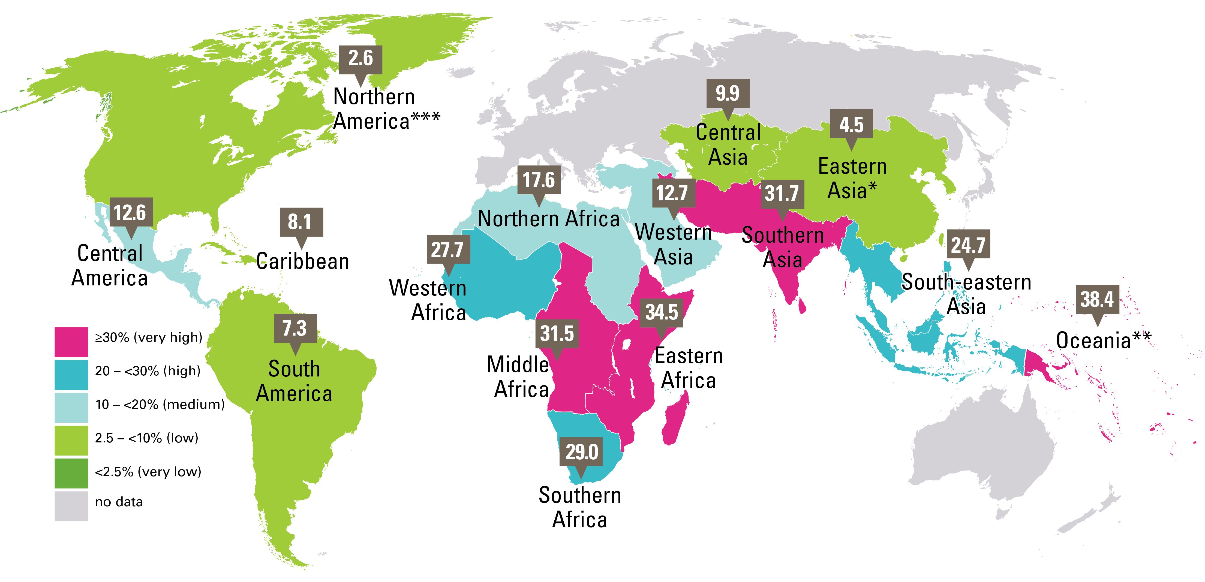
STUNTING
Prevalence, UN sub-regions, 2019
Percentage of stunted children under 5, by UN sub-region
UNICEF, WHO, World Bank Group joint malnutrition estimates, 2020 edition. Note: *Eastern Asia excluding Japan; **Oceania excluding Australia and New Zealand; ***Northern America sub-regional estimate based on United States data. There is no estimate available for the sub-regions of Europe or Australia and New Zealand due to insufficient population coverage. These maps are stylized and not to scale and do not reflect a position by UNICEF, WHO or World Bank Group on the legal status of any country or territory or the delimitation of any frontiers.

Slide 7
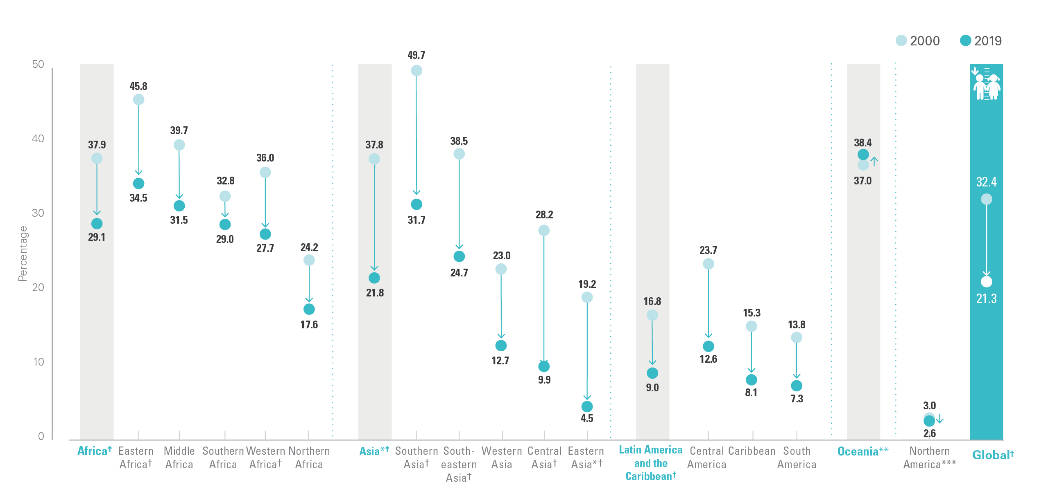
STUNTING
Trends: Prevalence, 2000 & 2019, by UN sub-region
Trends in the percentage of stunted children under 5, by UNICEF region, 2000 and 2019
Source: UNICEF, WHO, World Bank Group joint malnutrition estimates, 2020 edition. Note: *Asia and Eastern Asia excluding Japan; **Oceania excluding Australia and New Zealand; ***Northern America sub-regional estimates based on United States data. There is no estimate available for the More Developed Region or for sub-regions of Europe or Australia and New Zealand due to insufficient population coverage. ?represents regions/sub-regions where the change has been statistically significant; see page 12 for the 95% confidence intervals for graphed estimates.

Slide 8
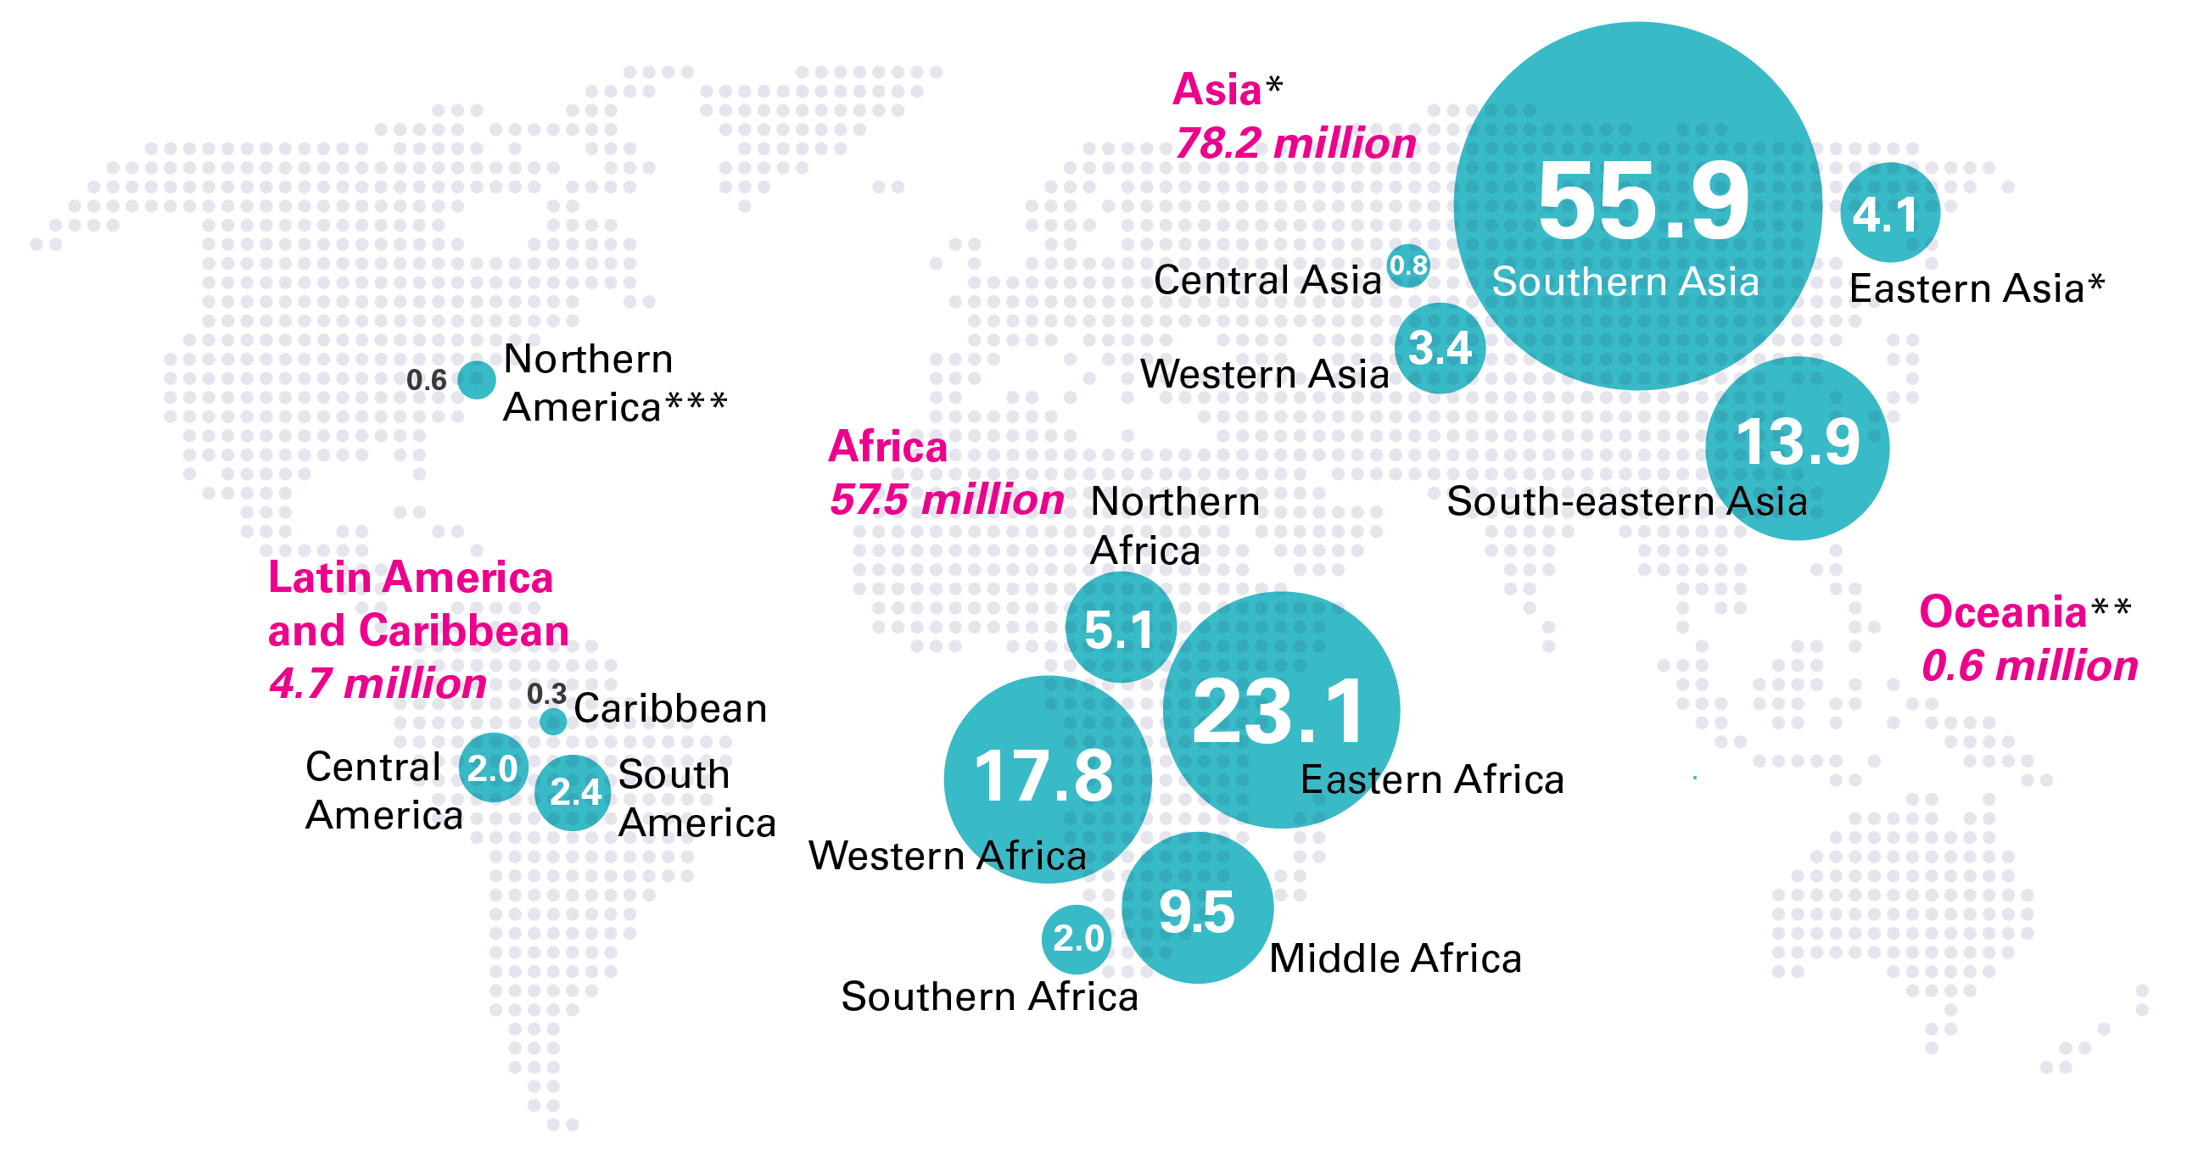
STUNTING
Numbers affected, by UN sub-region, 2019
Number (millions) of stunted children under 5, by UN sub-region, 2019
Source: UNICEF, WHO, World Bank Group joint malnutrition estimates, 2020 edition. Note: *Eastern Asia excluding Japan; **Oceania excluding Australia and New Zealand; ***The Northern America sub-regional estimate based on United States data. There is no estimate available for the More Developed Region or for sub-regions of Europe or Australia and New Zealand due to insufficient population coverage. Aggregates may not add up due to rounding and/or lack of estimates for the More Developed Region.

Slide 9
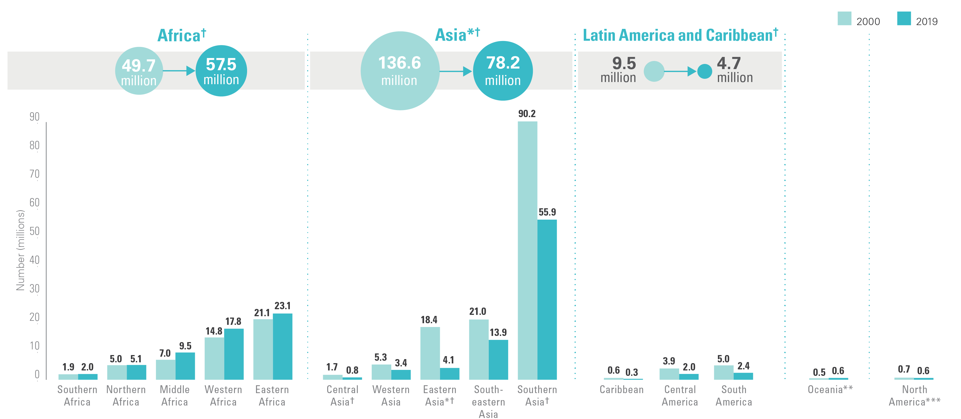
STUNTING
Numbers affected, by UN sub-region, 2000 & 2019
Trends in the number of stunted children under 5, by United Nations region/sub-region, 2000 and 2019
Source: UNICEF, WHO, World Bank Group Joint Child Malnutrition Estimates, 2019 edition. Note: *Asia and Eastern Asia excluding Japan. **Oceania excluding Australia and New Zealand. ***Northern America sub-regional average based on United States data only. There is no estimate available for the More Developed Region or for sub-regions of Europe or Australia and New Zealand. †represents regions/sub-regions where the change has been statistically significant; see page 13 for the 95% confidence intervals for graphed estimates.

Slide 10
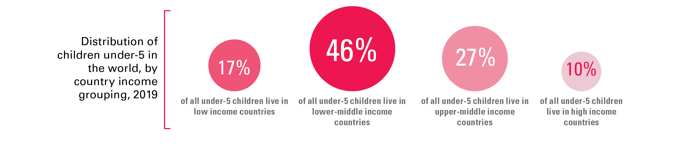
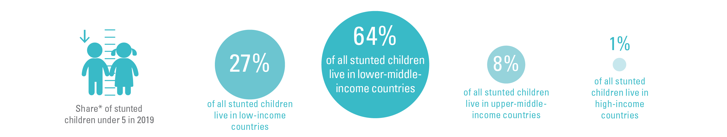
COUNTRY INCOME CLASSIFICATION
Share by region
While only about half of all children under 5 live in lower-middle incomes,
two-thirds of all stunted children and three-quarters of all wasted children live there
*Share is relative to the total number affected across the 4 country-income groups; this varies from the global totals reported elsewhere in this brochure because the official JME global total is based on a model of United Nations regions. The differences are as follows: Stunting official global estimate 144.0 million; sum of 4 country-income groups = 145.8 million. Wasting official global estimate 47.0 million; sum of country-income groups = 45.3 million. Overweight official global estimate 38.3 million; sum of 4 country-income groups = 39.1 million).

Slide 11
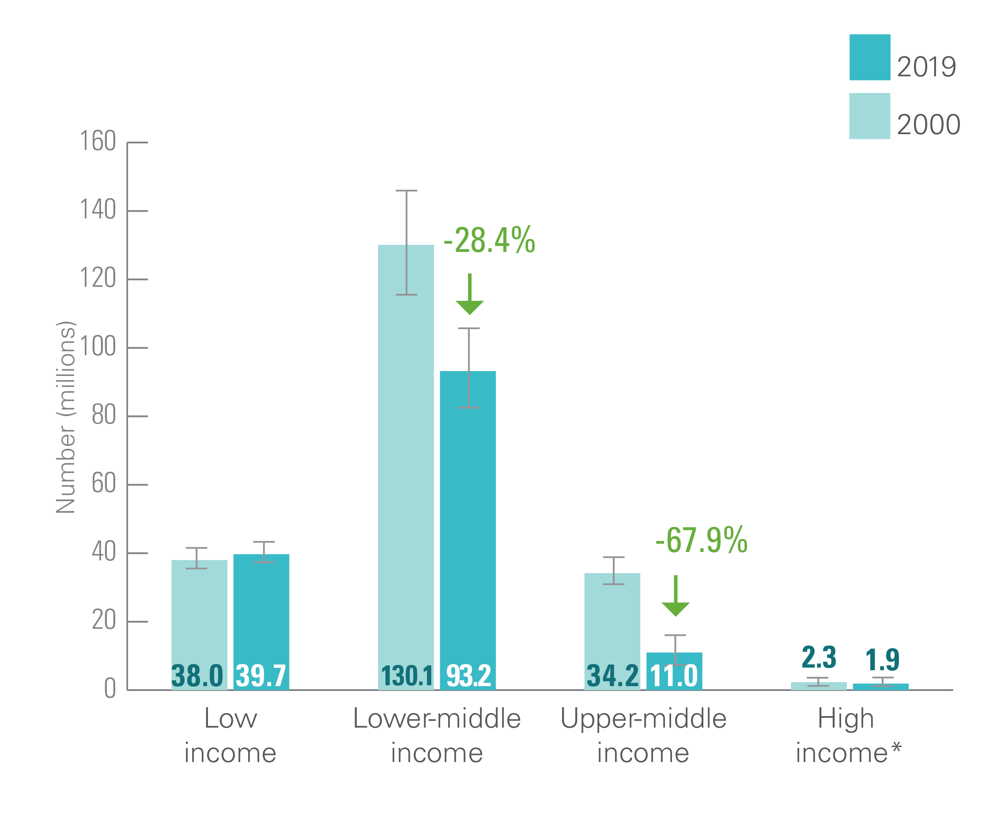
STUNTING: COUNTRY INCOME CLASSIFICATION
Trends, Numbers affected, 2000 and 2019, World Bank
Number (millions) of children under 5 who are stunted, by World Bank Income Classification, 2000 and 2019
Source: UNICEF, WHO, World Bank Group joint malnutrition estimates, 2020 edition. Note: *High-income countries: consecutive low (<50 per cent) population coverage in 2000 and 2019 for overweight and in 2000 for stunting; interpret with caution. Based on FY2020 World Bank income classification. The values for “percentage change since 2000” are based on calculations using unrounded estimates and therefore might not match values calculated using the rounded estimates presented in this brochure.

Slide 12

Wasting refers to a child who
is too thin for his or her height.
Wasting is the result of recent
rapid weight loss or the failure
to gain weight. A child who is
moderately or severely wasted
has an increased risk of death,
but treatment is possible.

Slide 13
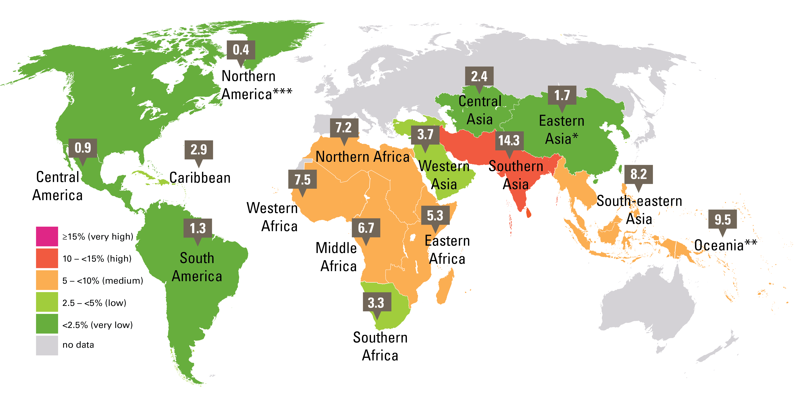
WASTING
Prevalence, UN sub-regions, 2019
Percentage of wasted children under 5, by UN sub-region
Source: UNICEF, WHO, World Bank Group joint malnutrition estimates, 2020 edition. Note: *Eastern Asia excluding Japan; **Oceania excluding Australia and New Zealand; ***Northern America sub-regional estimate based on United States data. There is no estimate available for the sub-regions of Europe or Australia and New Zealand due to insufficient population coverage. These maps are stylized and not to scale and do not reflect a position by UNICEF, WHO or World Bank Group on the legal status of any country or territory or the delimitation of any frontiers. The legend contains a category for ≥15 per cent (pink) but there is no sub-region with a prevalence this high.

Slide 14
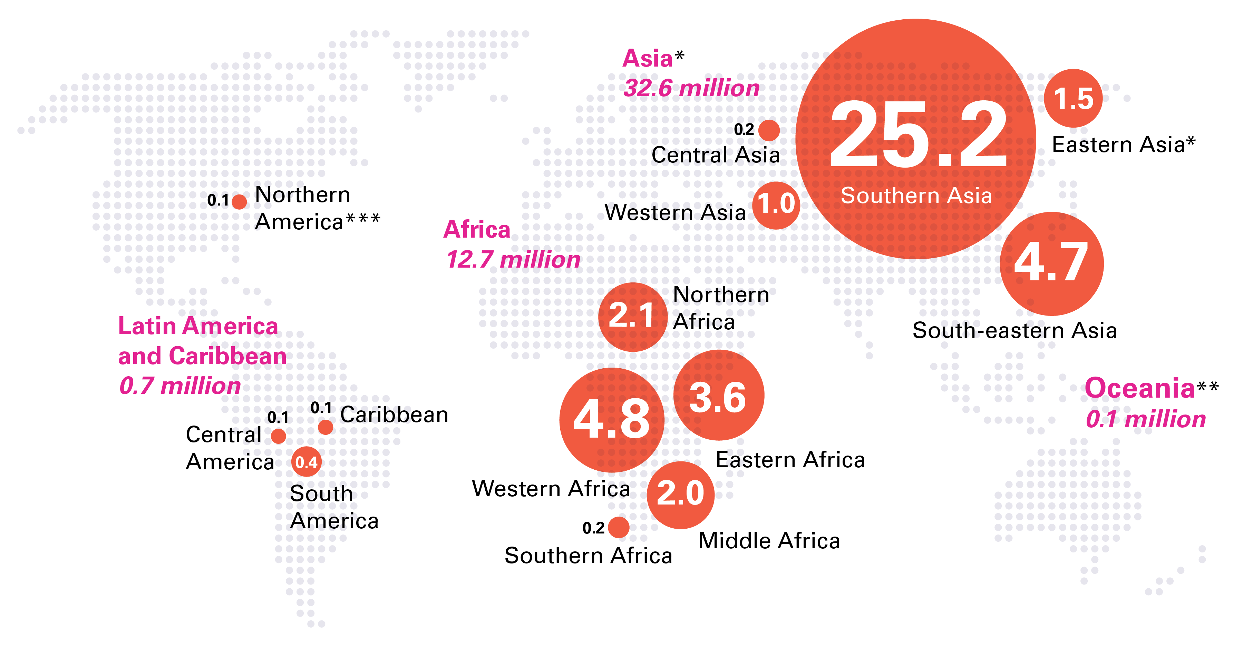
WASTING
Numbers affected, by UN sub-region, 2019
Number (millions) of wasted children under 5, by UN sub-region
Source: UNICEF, WHO, World Bank Group joint malnutrition estimates, 2020 edition. Note: *Eastern Asia excluding Japan; **Oceania excluding Australia and New Zealand; ***The Northern America sub-regional estimate based on United States data. There is no estimate available for the More Developed Region or for sub-regions of Europe or Australia and New Zealand due to insufficient population coverage. Aggregates may not add up due to rounding and/or lack of estimates for the More Developed Region.

Slide 15
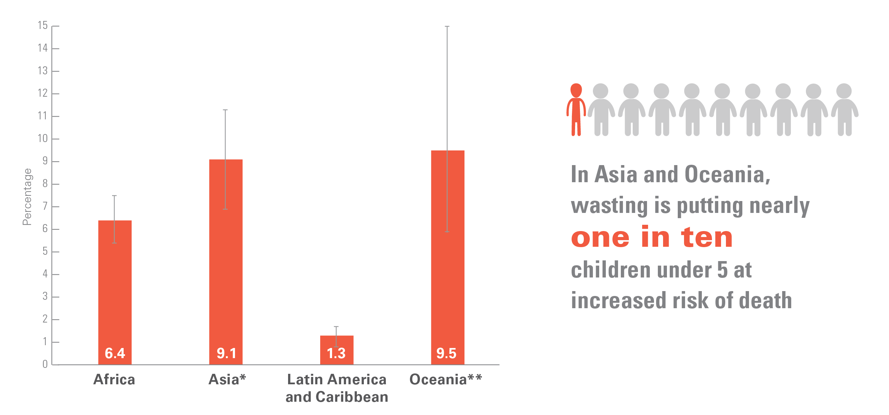
WASTING
Prevalence, UN sub-regions, 2019
Percentage of wasted children under 5, by UN region
Source: UNICEF, WHO, World Bank Group joint malnutrition estimates, 2020 edition. Includes 95% confidence interval. Note: *Asia excluding Japan; **Oceania excluding Australia and New Zealand. There is no estimate available for the More Developed Region due to insufficient population coverage.

Slide 16
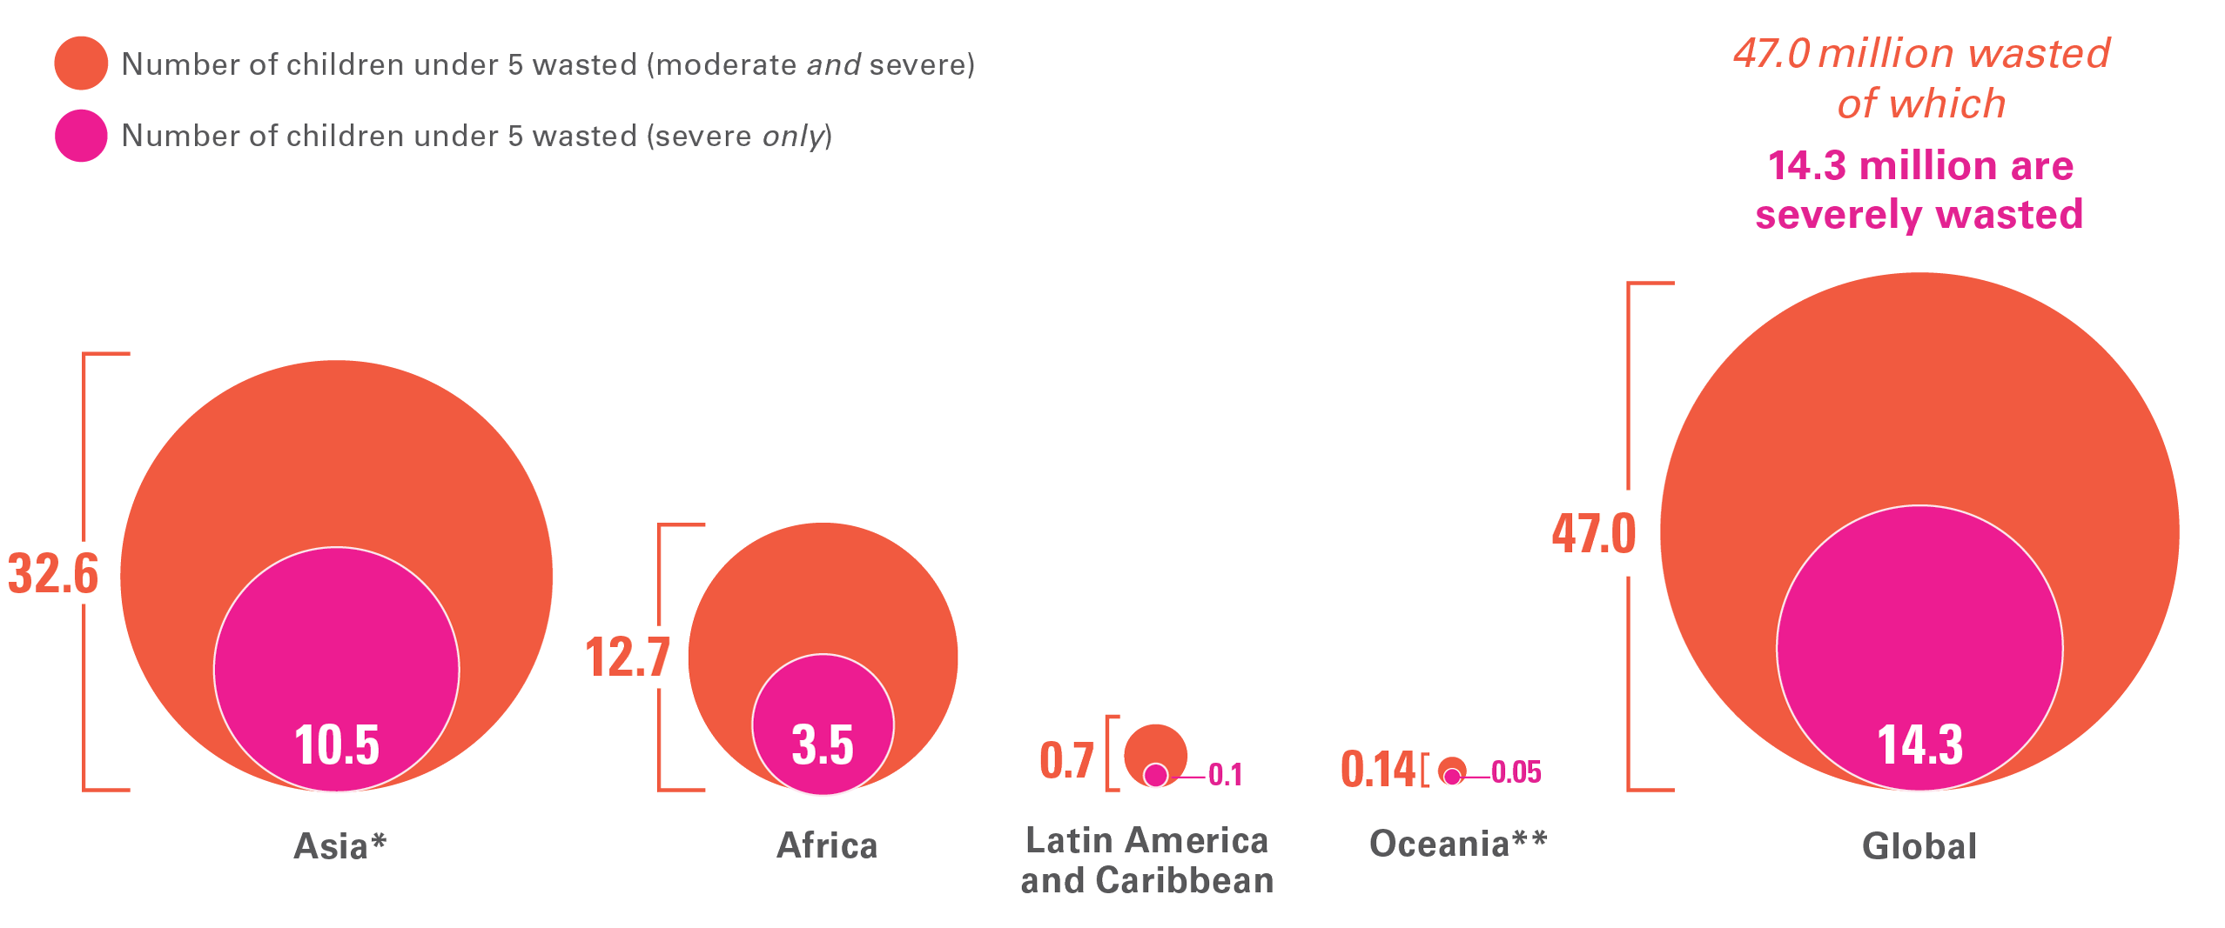
WASTING
Numbers affected, wasted and severely wasted, by UN region, 2019
Number (millions) of wasted and severely wasted children under 5, by UN region
Source: UNICEF, WHO, World Bank Group joint malnutrition estimates, 2020 edition. Note: *Asia excluding Japan; **Oceania excluding Australia and New Zealand. There is no estimate available for the More Developed Region due to insufficient population coverage. Aggregates may not add up due to rounding and/or lack of estimates for the More Developed Region.

Slide 17
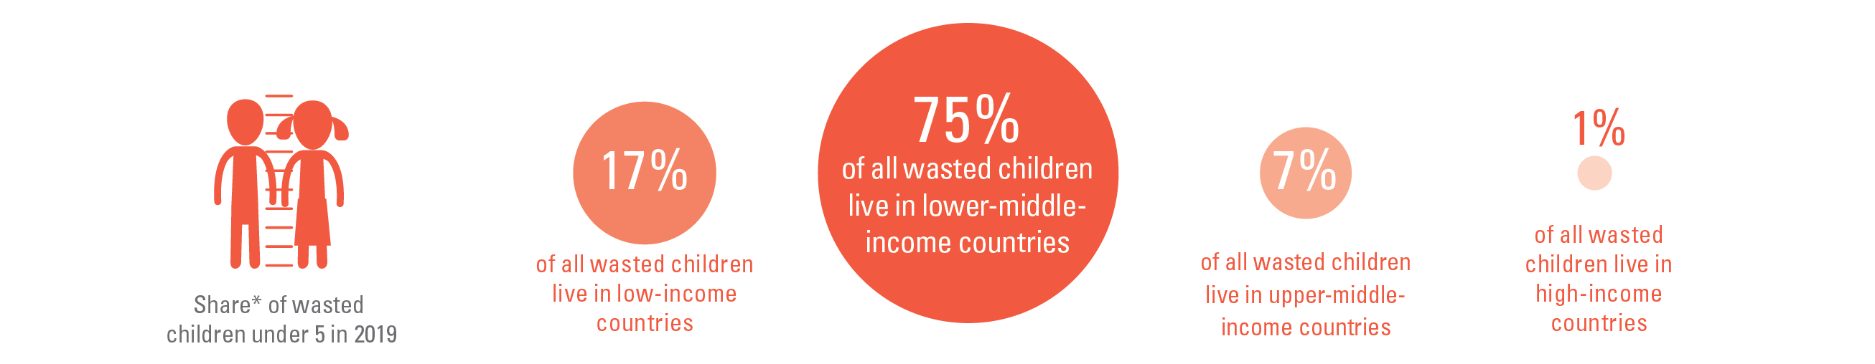
COUNTRY INCOME CLASSIFICATION
Share by region
While only about half of all children under 5 live in lower-middle incomes,
three-quarters of all wasted children live there
*Share is relative to the total number affected across the 4 country-income groups; this varies from the global totals reported elsewhere in this brochure because the official JME global total is based on a model of United Nations regions. The differences are as follows: Stunting official global estimate 144.0 million; sum of 4 country-income groups = 145.8 million. Wasting official global estimate 47.0 million; sum of country-income groups = 45.3 million. Overweight official global estimate 38.3 million; sum of 4 country-income groups = 39.1 million).

Slide 18
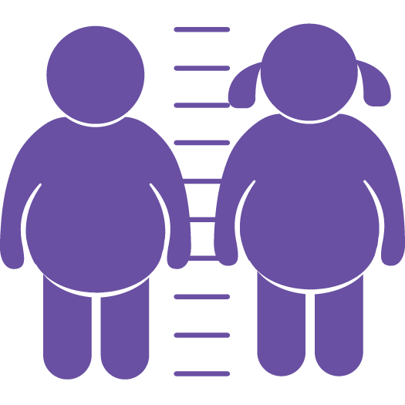
Overweight refers to a child
who is too heavy for his or her
height. This form of malnutrition results from energy intakes from
food and beverages that exceed
children’s energy requirements.
Overweight increases the risk of diet-related non-communicable
diseases later in life.

Slide 19
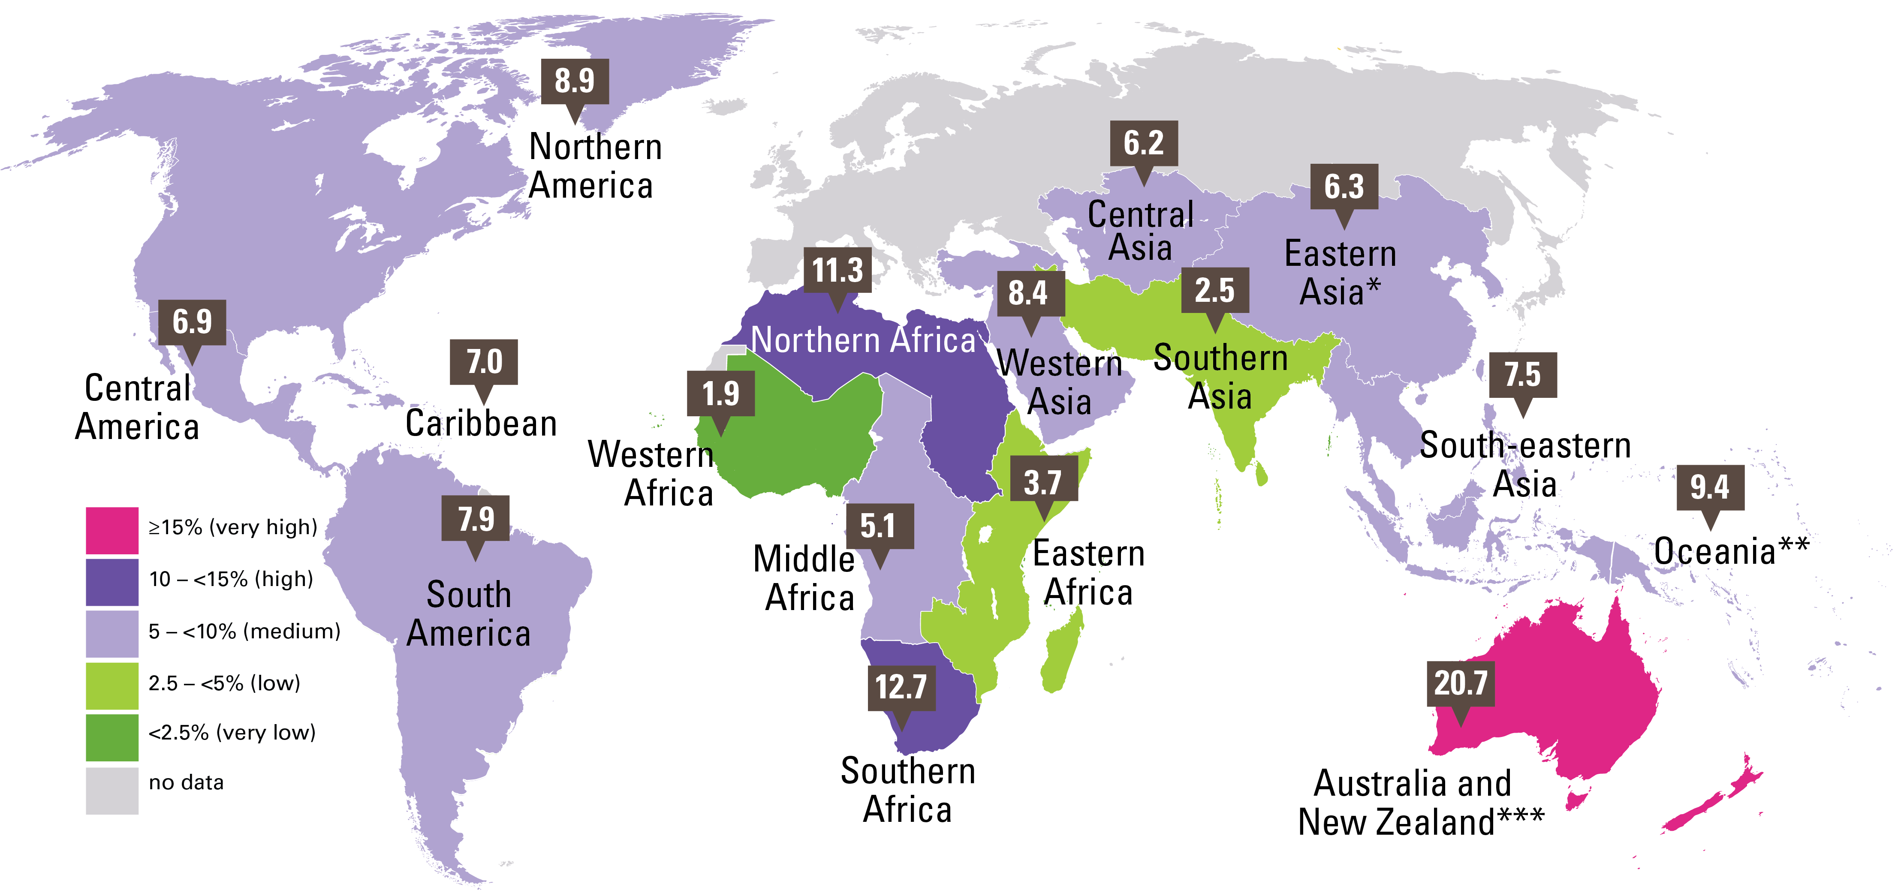
OVERWEIGHT
Prevalence, UN sub-regions, 2019
Percentage of overweight children under 5, by UN sub-region
Source: UNICEF, WHO, World Bank Group joint malnutrition estimates, 2020 edition. Note: *Eastern Asia excluding Japan; **Oceania excluding Australia and New Zealand, ***The Australia and New Zealand sub-regional estimate is based only on Australia data. There is no estimate available for the sub-region of Europe due to insufficient population coverage. These maps are stylized and not to scale and do not reflect a position by UNICEF, WHO or World Bank Group on the legal status of any country or territory or the delimitation of any frontiers.

Slide 20
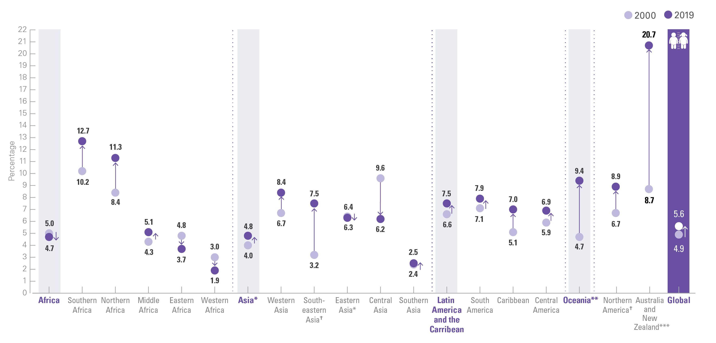
STUNTING
Trends: Prevalence, 2000 & 2019, by UN sub-region
Trends in the percentage of overweight children under 5, by United Nations region/sub-region, 2000 and 2019
Source: UNICEF, WHO, World Bank Group joint malnutrition estimates, 2020 edition. Note:*Asia and Eastern Asia excluding Japan; **Oceania excluding Australia and New Zealand. ***The Australia and New Zealand sub-regional estimates are based only on Australia data. There is no estimate available for the More Developed Region or for the sub-region of Europe due to insufficient population coverage. ?represents sub-regions where the change has been statistically significant; see page 12 for the 95% confidence intervals for graphed estimates.

Slide 21
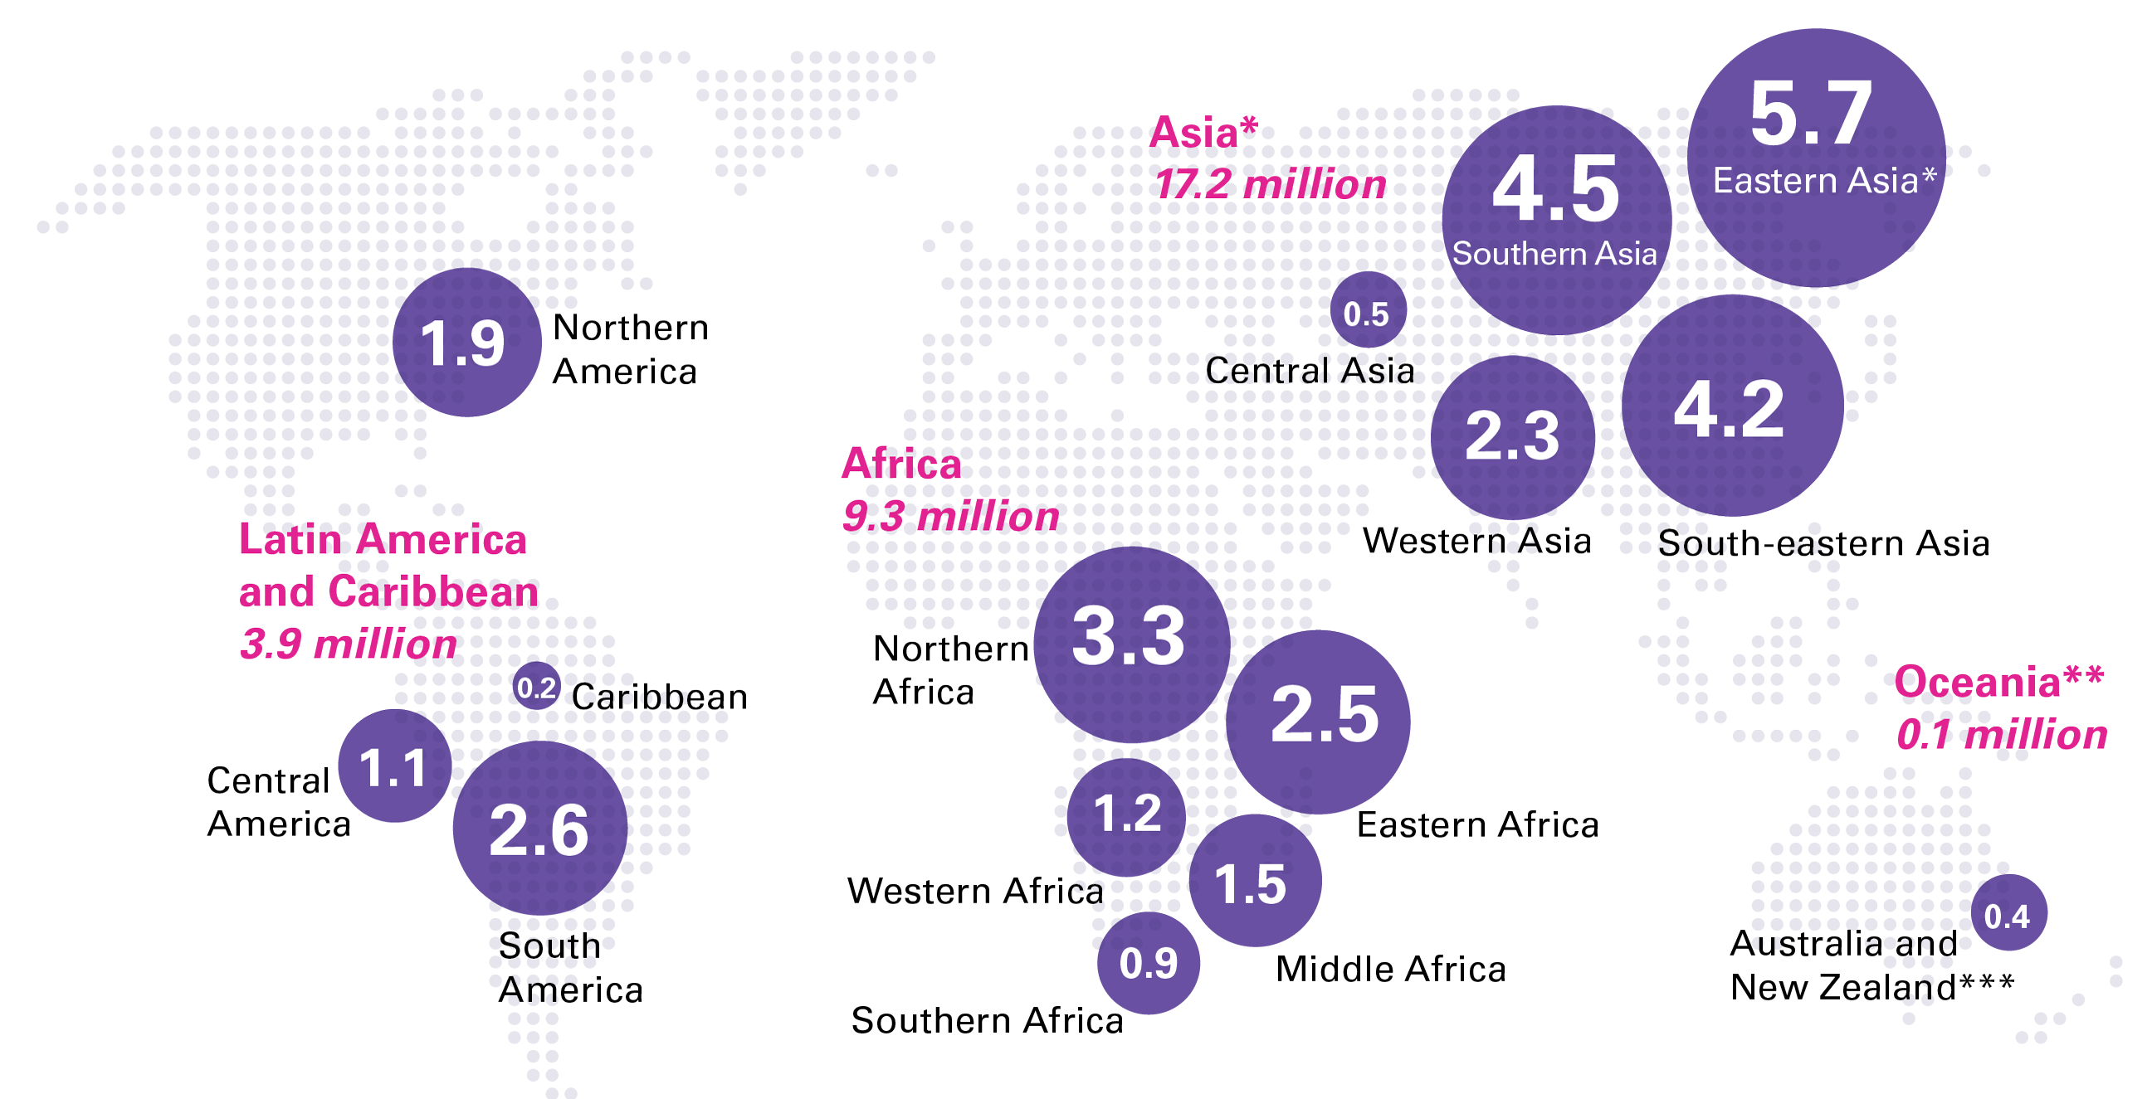
OVERWEIGHT
Numbers affected, by UN sub-region, 2019
Number (millions) of overweight children under 5, by UN sub-region
Source: UNICEF, WHO, World Bank Group joint malnutrition estimates, 2020 edition. Note:*Eastern Asia excluding Japan; **Oceania excluding Australia and New Zealand. ***The Australia and New Zealand sub-regional estimate is based only on Australia data. There is no estimate available for the More Developed Region or for the sub-region of Europe due to insufficient population coverage. Aggregates may not add up due to rounding and/or lack of estimates for the More Developed Region.

Slide 22
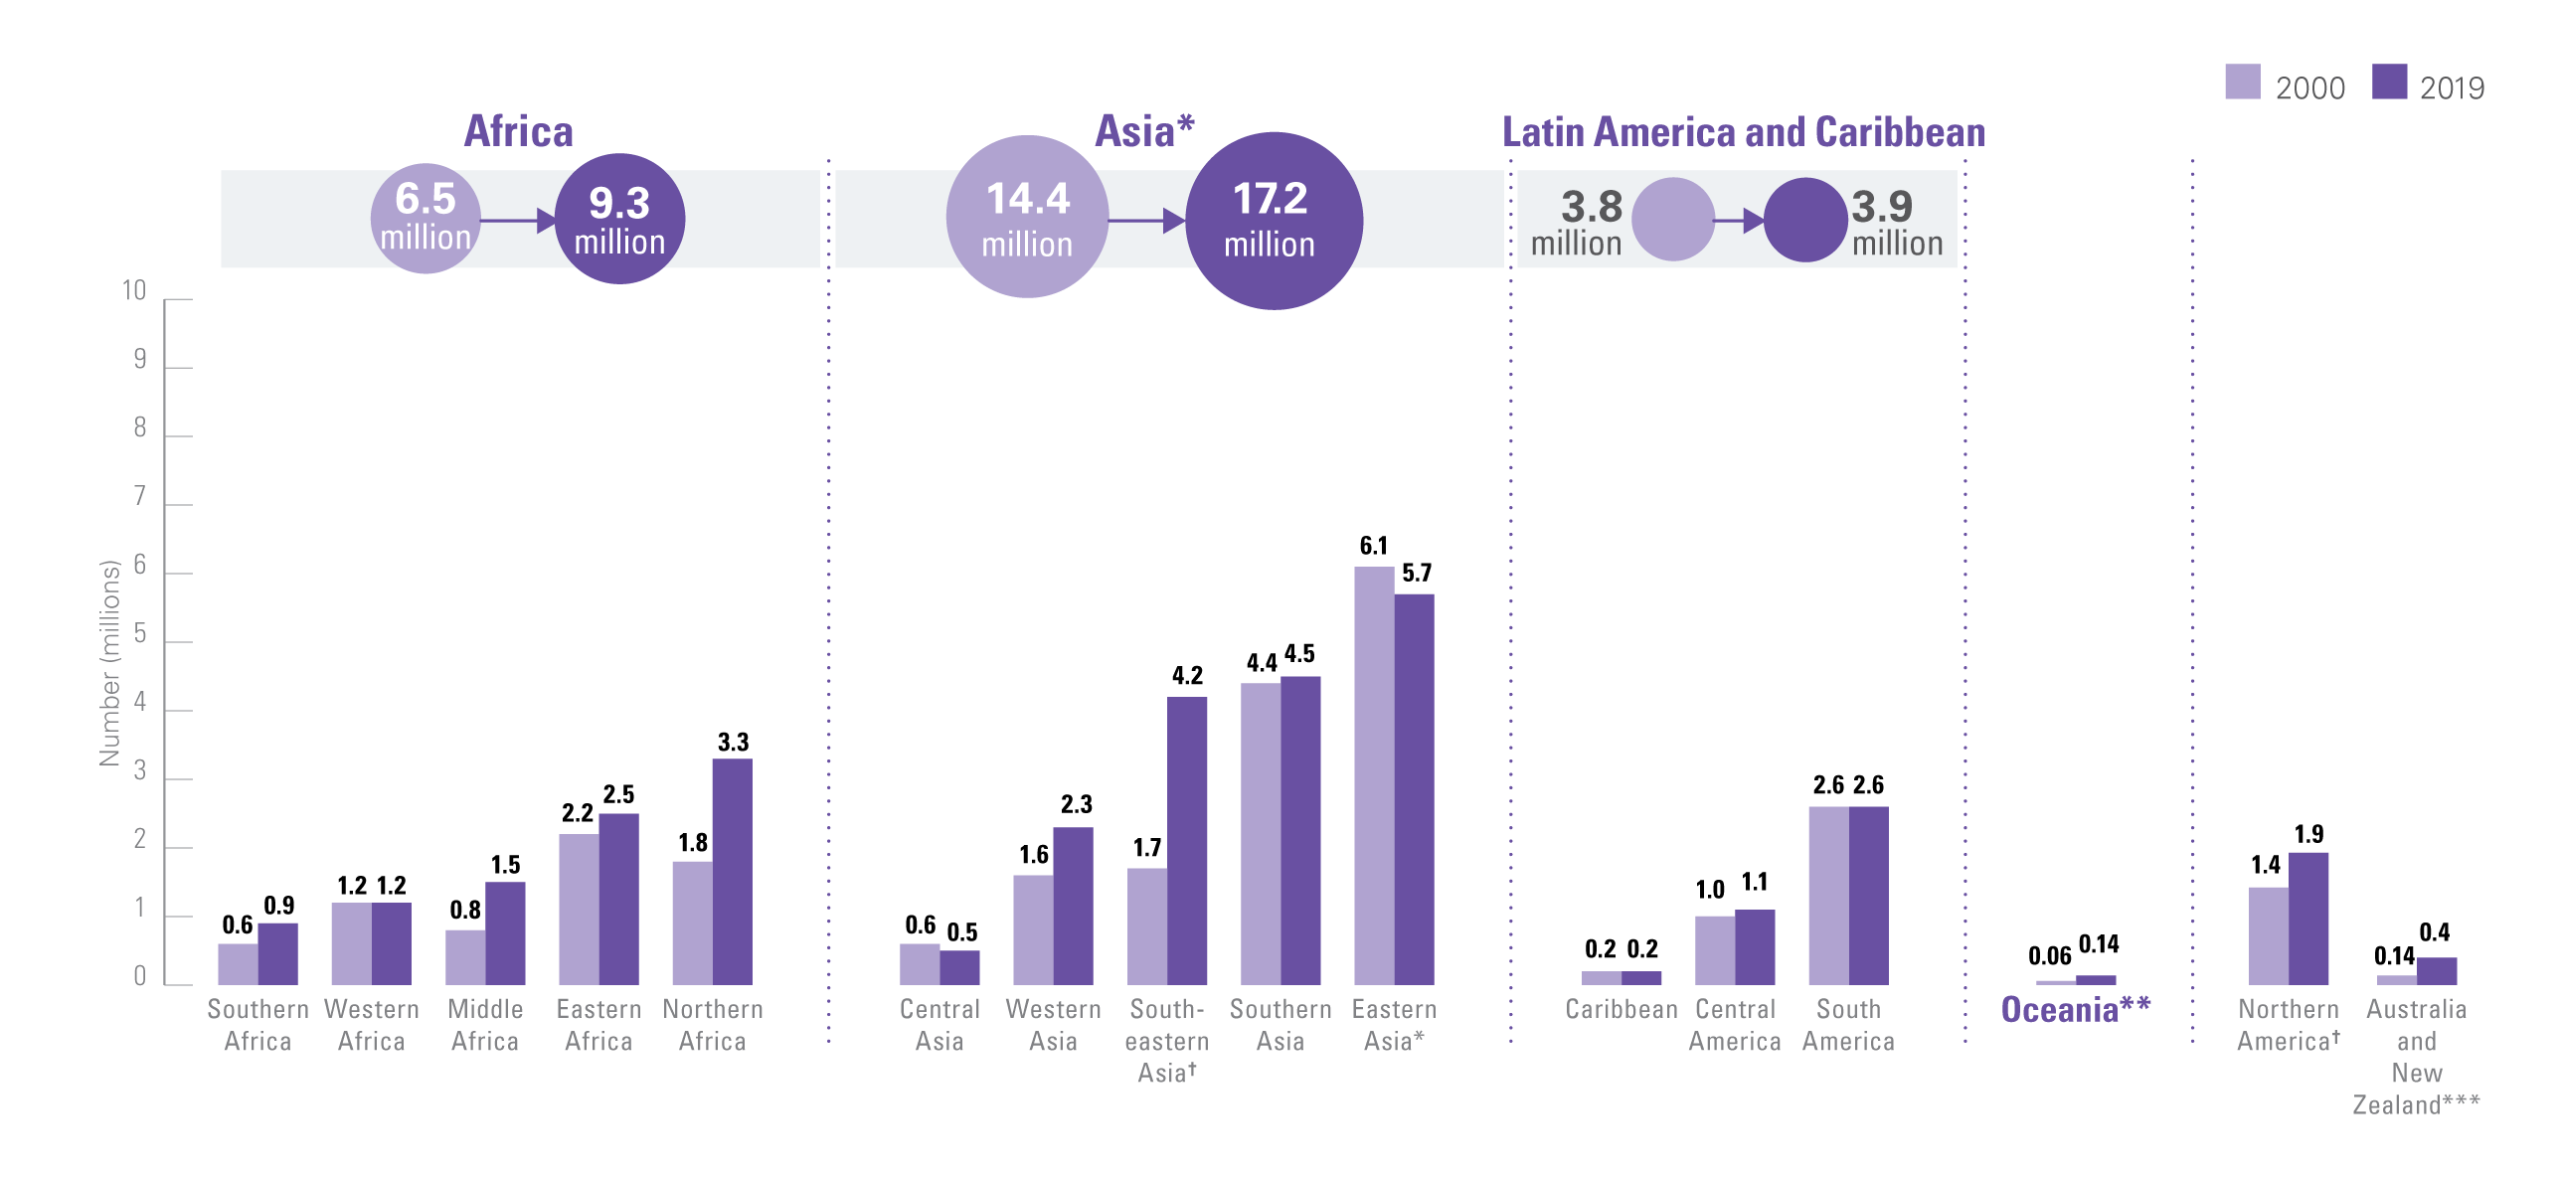
OVERWEIGHT
Numbers affected, by UN sub-region, 2000 & 2019
Trends in the number of overweight children under 5, by United Nations region/sub-region, 2000 – 2019
Source: UNICEF, WHO, World Bank Group joint malnutrition estimates, 2020 edition. Note: *Asia and Eastern Asia excluding Japan; **Oceania excluding Australia and New Zealand. ***The Australia and New Zealand sub-regional estimates are based only on Australia data. There is no estimate available for the More Developed Region or for the sub-region of Europe due to insufficient population coverage. ?represents sub-regions where the change has been statistically significant; see page 13 for the 95% confidence intervals for graphed estimates.

Slide 23
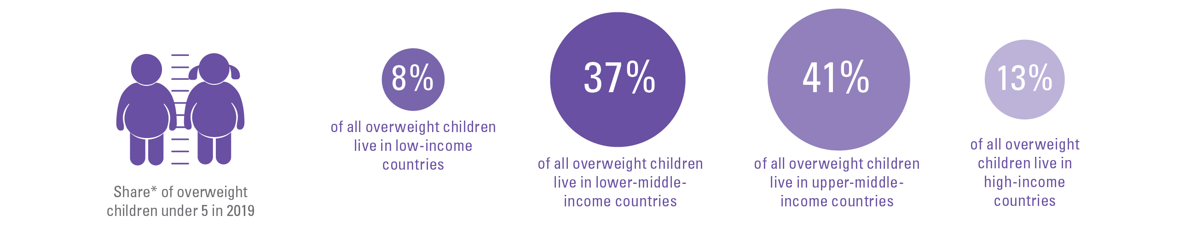
COUNTRY INCOME CLASSIFICATION
Share by region
Middle income countries account for over three quarters of all overweight children
*Share is relative to the total number affected across the 4 country-income groups; this varies from the global totals reported elsewhere in this brochure because the official JME global total is based on a model of United Nations regions. The differences are as follows: Stunting official global estimate 144.0 million; sum of 4 country-income groups = 145.8 million. Wasting official global estimate 47.0 million; sum of country-income groups = 45.3 million. Overweight official global estimate 38.3 million; sum of 4 country-income groups = 39.1 million).

Slide 24
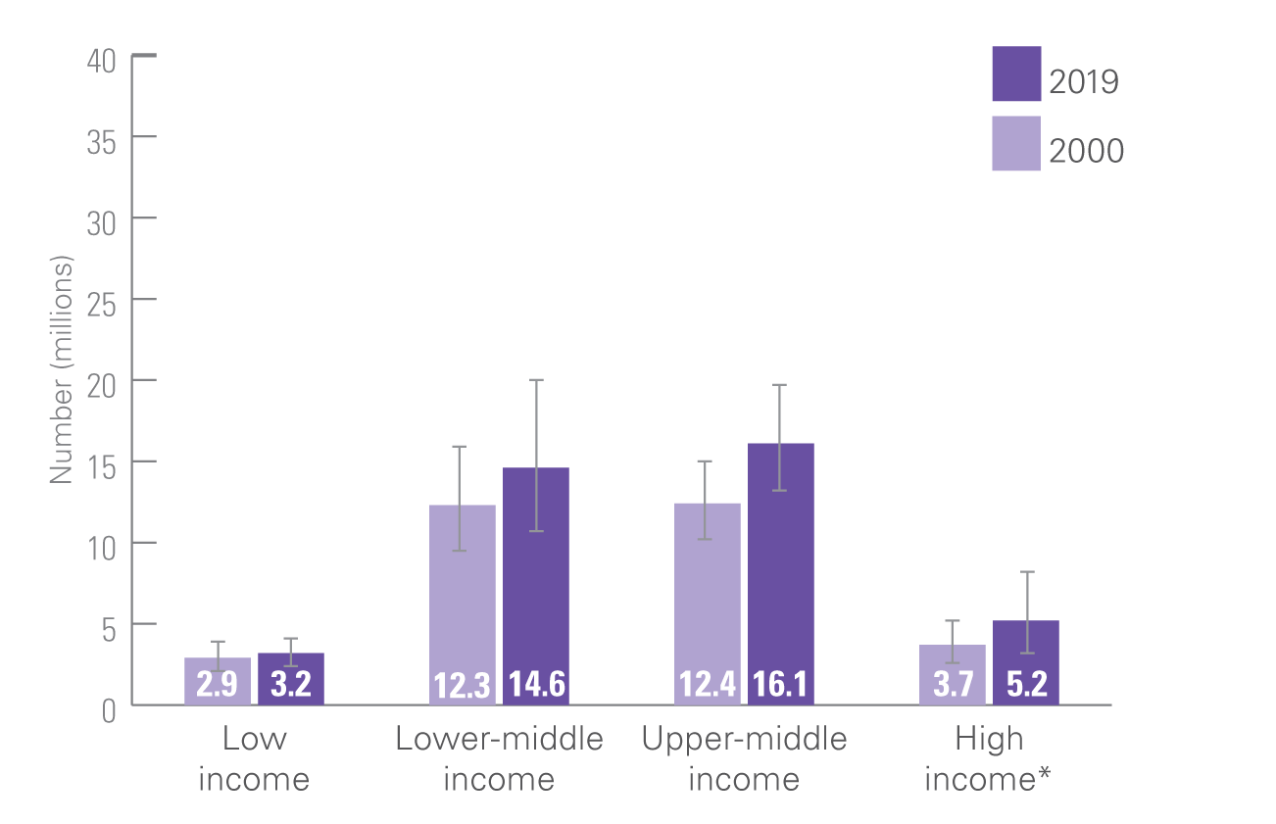
OVERWEIGHT: COUNTRY INCOME CLASSIFICATION
Trends, Numbers affected, 2000 and 2019, World Bank
Number (millions) of children under 5 who are overweight, by World Bank Income Classification, 2000 and 2019
Source: UNICEF, WHO, World Bank Group joint malnutrition estimates, 2020 edition. Note: *High-income countries: consecutive low (<50 per cent) population coverage in 2000 and 2019 for overweight and in 2000 for stunting; interpret with caution. Based on FY2020 World Bank income classification. The values for “percentage change since 2000” are based on calculations using unrounded estimates and therefore might not match values calculated using the rounded estimates presented in this brochure.

Slide 25
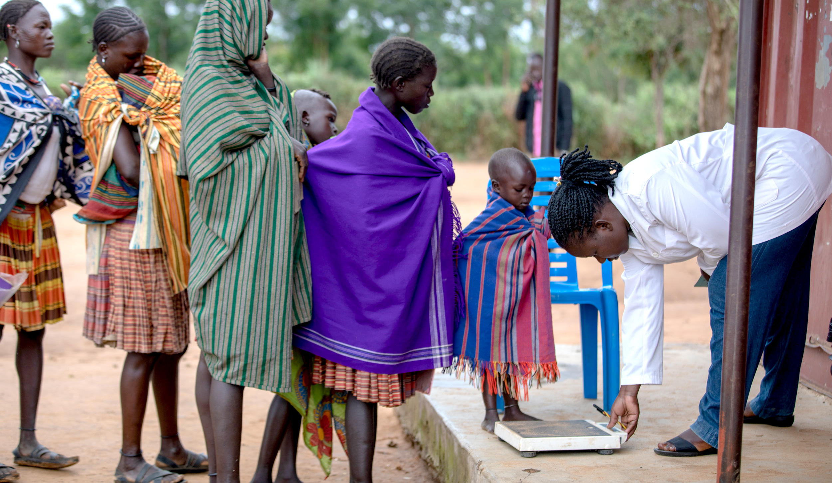

NOTES ON THE DATA AND METHODOLOGY

Slide 26
Strengths and weaknesses of malnutrition data
Prevalence estimates for stunting and overweight are relatively stable over the course of a calendar year. It is therefore possible to track global and regional changes in these two conditions over time. Wasting and severe wasting are acute conditions that can change frequently and rapidly over the course of a calendar year. This makes it difficult to generate reliable trends over time with the input data available, and as such, this report provides only most recent global and regional estimates.
The joint global and regional estimates that make up the UNICEF/ WHO/World Bank Group Joint Child Malnutrition Estimates have been generated using a country-level dataset which is mainly comprised of estimates from nationally representative household surveys. These data are collected infrequently (every 3 to 5 years in most countries) and measure malnutrition at one point in time (e.g. during one or several months of field work), making it difficult to capture the rapid fluctuations in wasting that can occur over the course of a given year. Incidence data (i.e. the number of new cases that occur during the calendar year) would allow for better tracking of changes over time; however, these data currently do not exist.

Slide 27
The analysis methods and presentation have remained unchanged from the 2012 report¹, except for minor refinements detailed below:
1. Year assigned to each survey
When data collection begins in one calendar year and continues into the next, the survey year assigned is the one in which most of the fieldwork took place. For example, if a survey was conducted between 1 September 2009 and 28 February 2010, the year 2009 would be assigned, since the majority of data collection took place in that year (i.e., four months in 2009 versus two months in 2010). This method has been used since the 2013 edition (prior to that, the latter year was used by default – e.g., 2010 in the example above).
2. Final reports only
As of the 2014 edition, the country-level dataset used to generate the global and regional joint malnutrition estimates is based only on final survey results. Preliminary survey results are no longer included in the
dataset since the data are sometimes retracted or change significantly
when the final version is released.
3. Updated data sources
i. The updated joint dataset includes:
• 854 nationally representative surveys;
• data from 152 countries and territories, representing more than 90 per cent of all children under 5 globally (population coverage varies by regions and periods). The majority of data available are from low- and middle-income countries – more efforts are needed to generate data from high-income countries.
ii. The under 5 population estimates were based on The United Nations World Population Prospects, 2017 Revision. These were used as weighting factors for each country survey to derive the regional and global prevalence estimates and calculate the numbers affected.
iii. Regional and country income classifications were based on FY19 World Bank income classification.
4. Footnotes on population coverage
As started in the 2014 edition, a separate exercise was conducted to assess population coverage. This was important in order to alert the reader, via footnotes, to instances where the data should be interpreted with caution due to low population coverage (defined as less than 50 per cent). A conservative method was applied looking at available data within mutually exclusive five-year periods around the projected years.
1 United Nations Children’s Fund, World Health Organization, The World Bank. UNICEF-WHO-World Bank Joint Child Malnutrition Estimates. (UNICEF, New York; WHO, Geneva; The World Bank, Washington, DC; 2012).

Slide 28
The analysis methods and presentation have remained unchanged from the 2012 report¹, except for minor refinements detailed below:
5. Prevalence thresholds for wasting, overweight and
stunting in children under 5 years
New thresholds, presented in the table on the right, were established through the WHO-UNICEF Technical Advisory Group on Nutrition Monitoring (TEAM)² and have been used for development of prevalence-based maps in this brochure. The thresholds were developed in relation to standard deviations (SD) of the normative WHO Child Growth Standards. The international definition of ‘normal’ (two SD from the WHO standards median) defines the first threshold, which includes 2.3% of the area under the normalized distribution. Multipliers of this “very low” level (rounded to 2.5%) set the basis to establish subsequent thresholds.
Labels | Prevalence thresholds (%)
 | Stunting | Overweight and Wasting
Very Low | <2.5 | <2.5
Low | 2.5 – < 10 | 2.5 – < 5
Medium | 10 – < 20 | 5 – < 10
High | 20 – < 30 | 10 – < 15
Very high | ≥ 30 | ≥ 15
1 United Nations Children’s Fund, World Health Organization, The World Bank. UNICEF-WHO-World Bank Joint Child Malnutrition Estimates. (UNICEF, New York; WHO, Geneva; The World Bank, Washington, DC; 2012).
2 de Onis, M., et al. (2018). Prevalence thresholds for wasting, overweight and stunting in children under 5 years. Public health nutrition, 22(1), 175–179.

Slide 29
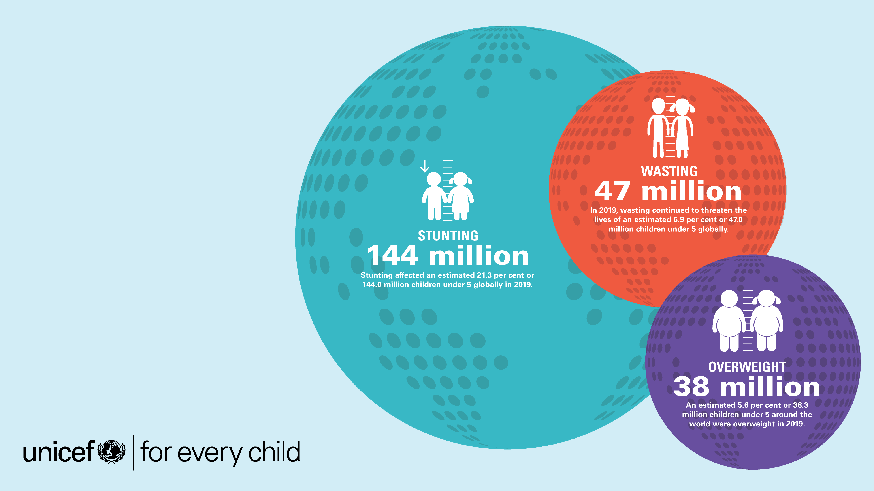
ONLINE
MATERIALS

Slide 30
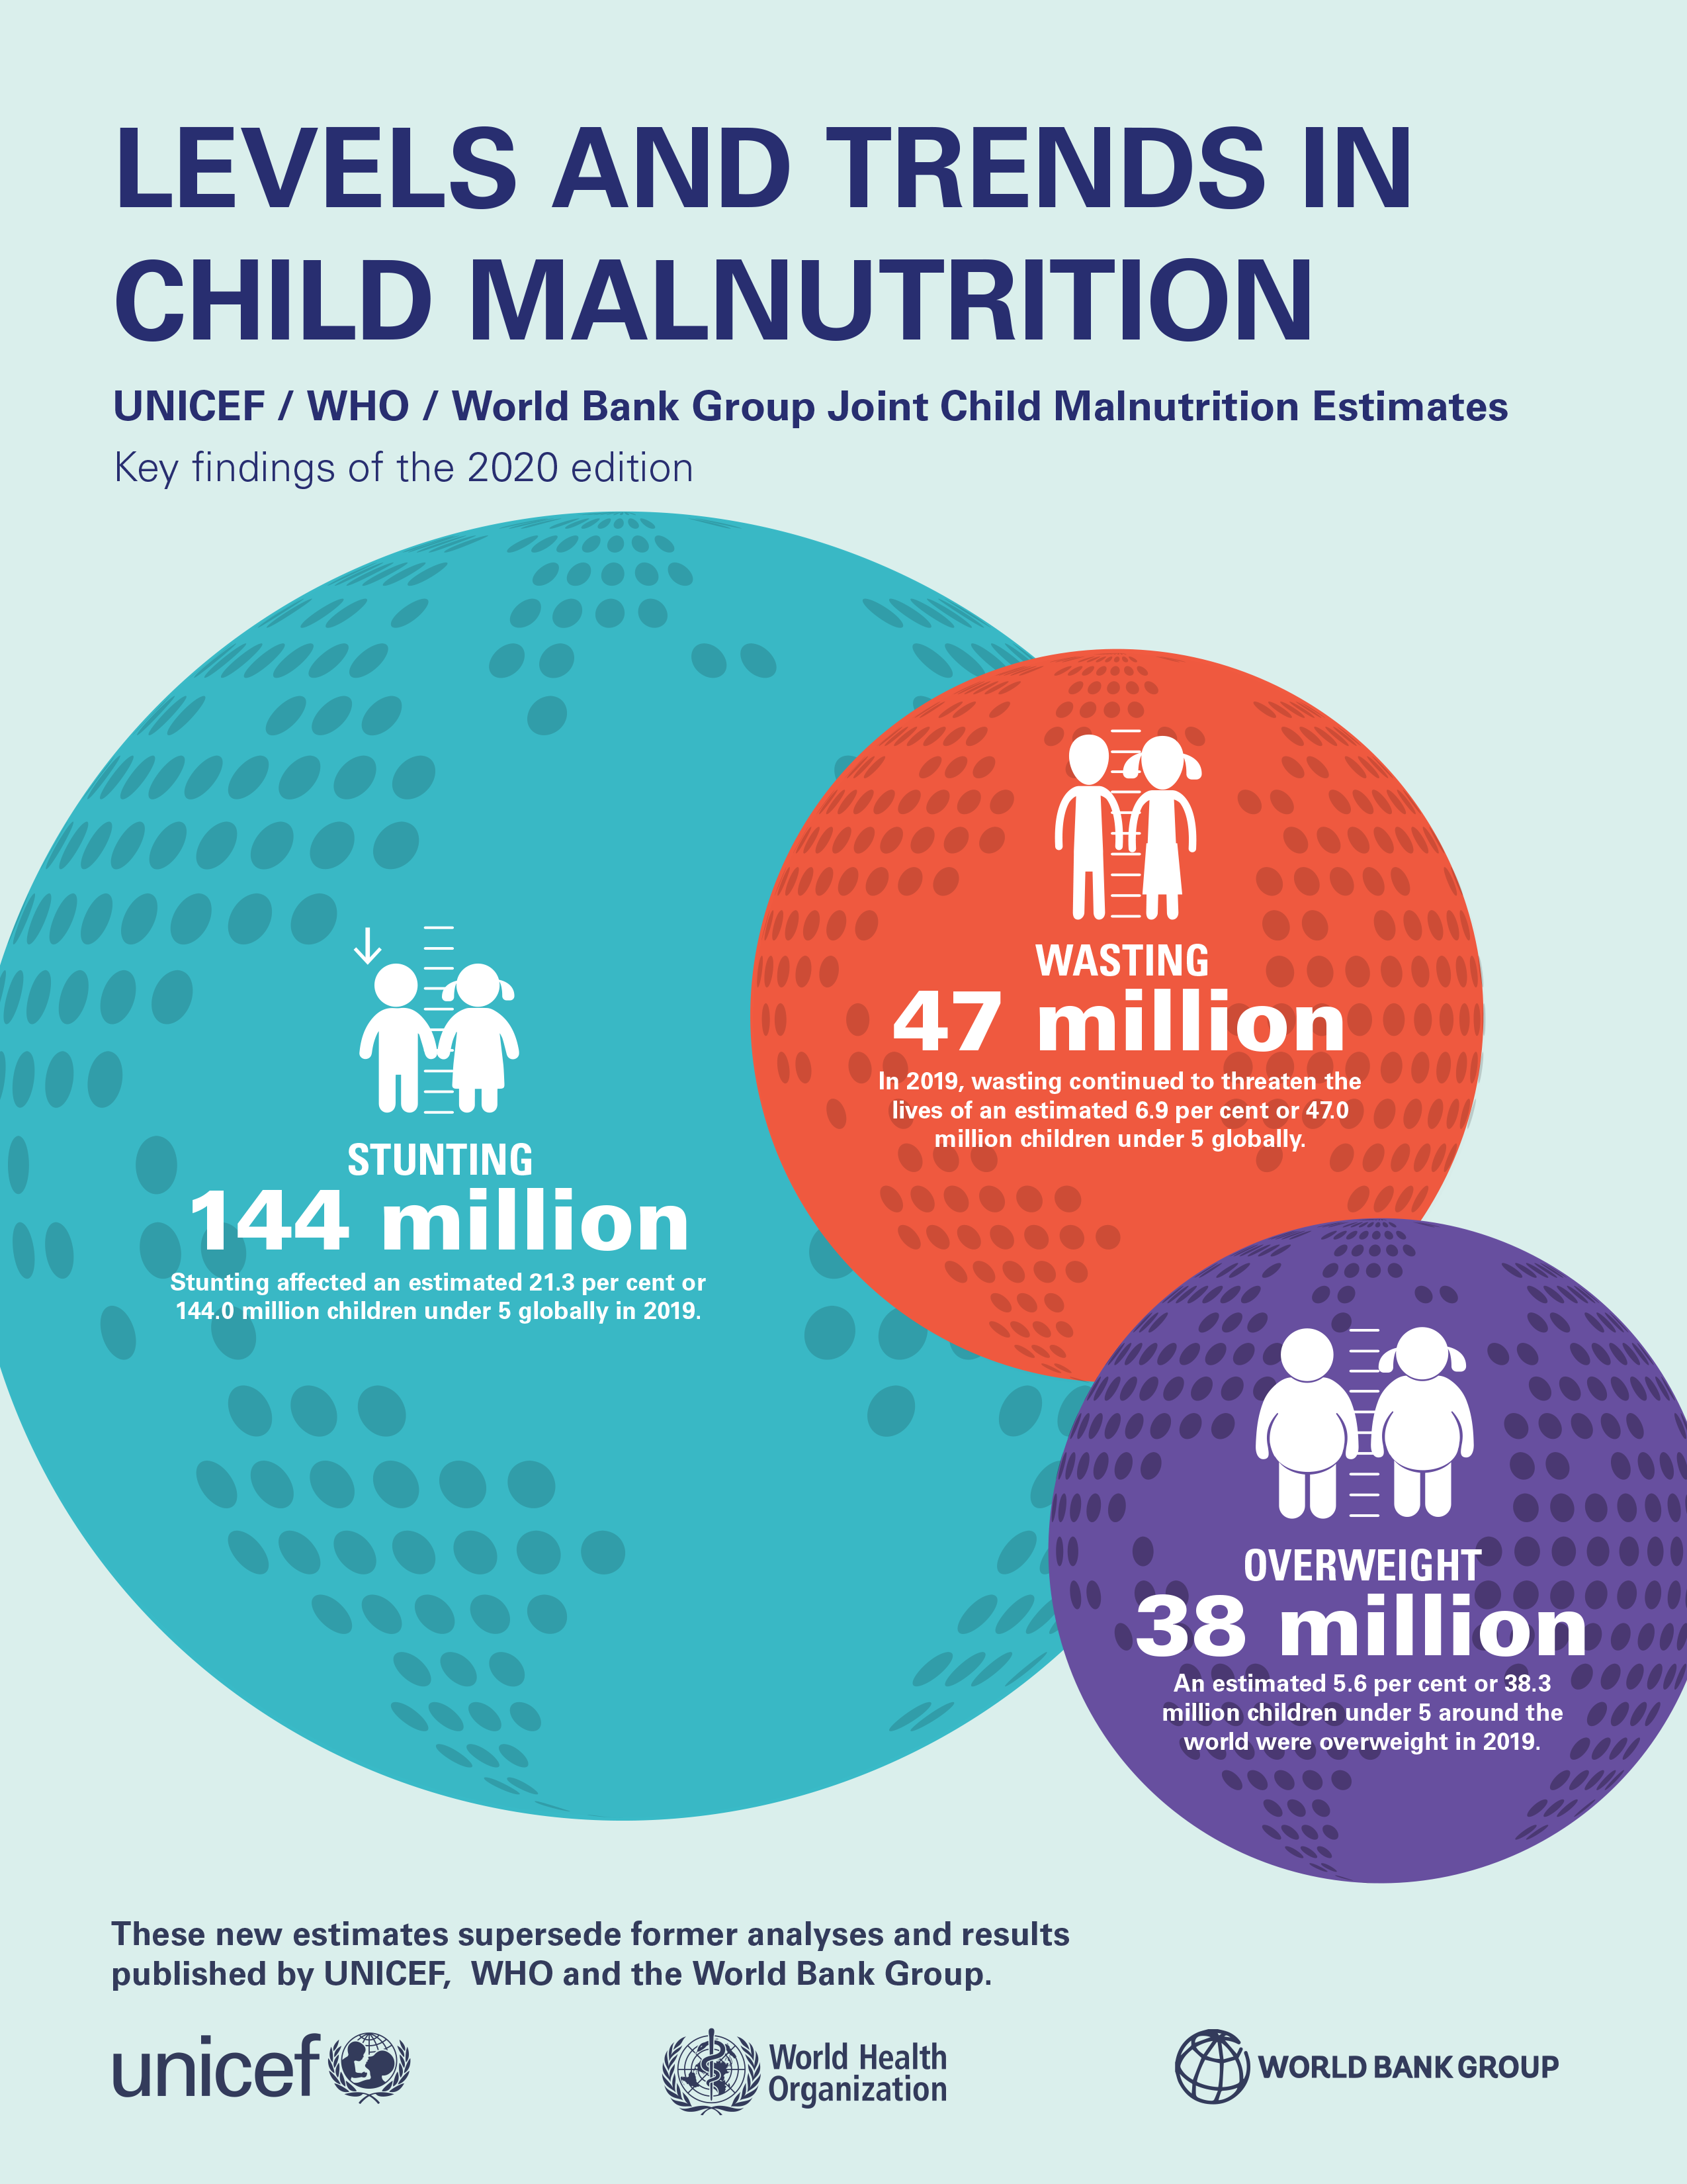
ONLINE MATERIALS
Key Findings Report
This key findings report of the 2020 Edition of the Joint Child Malnutrition Estimates summarizes the new regional and global numbers and main messages for official United Nations data on child malnutrition.
Available at: https://data.unicef.org/resources/jme-report-2020/

Slide 31
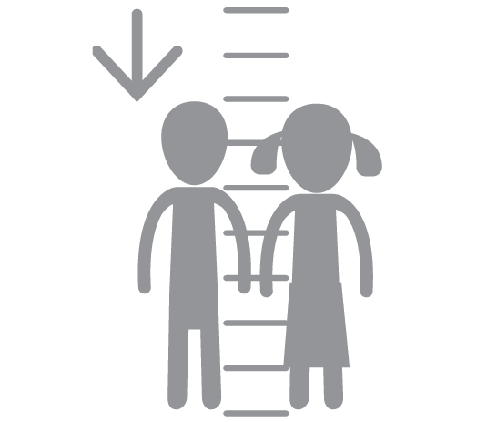
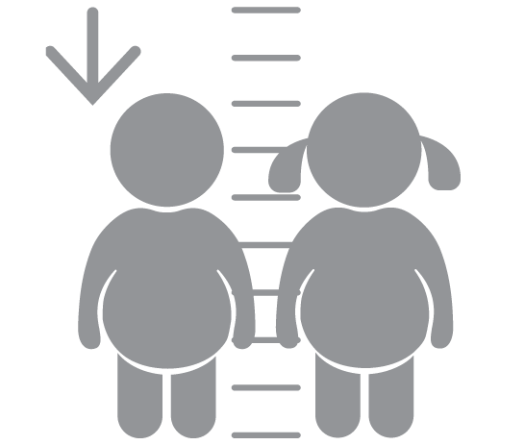
ONLINE MATERIALS
Databases
There are joint malnutrition global and regional estimates database by various regional groupings (e.g. United Nations, UNICEF, WHO, etc., regional groupings) and for more years than presented in the report.
There are also expanded databases (national and disaggregated) for the following indicators:
Stunting
Wasting
Severe Wasting
Overweight
Overlapping Malnutrition
Available at: https://data.unicef.org/resources/dataset/malnutrition-data/

Slide 32
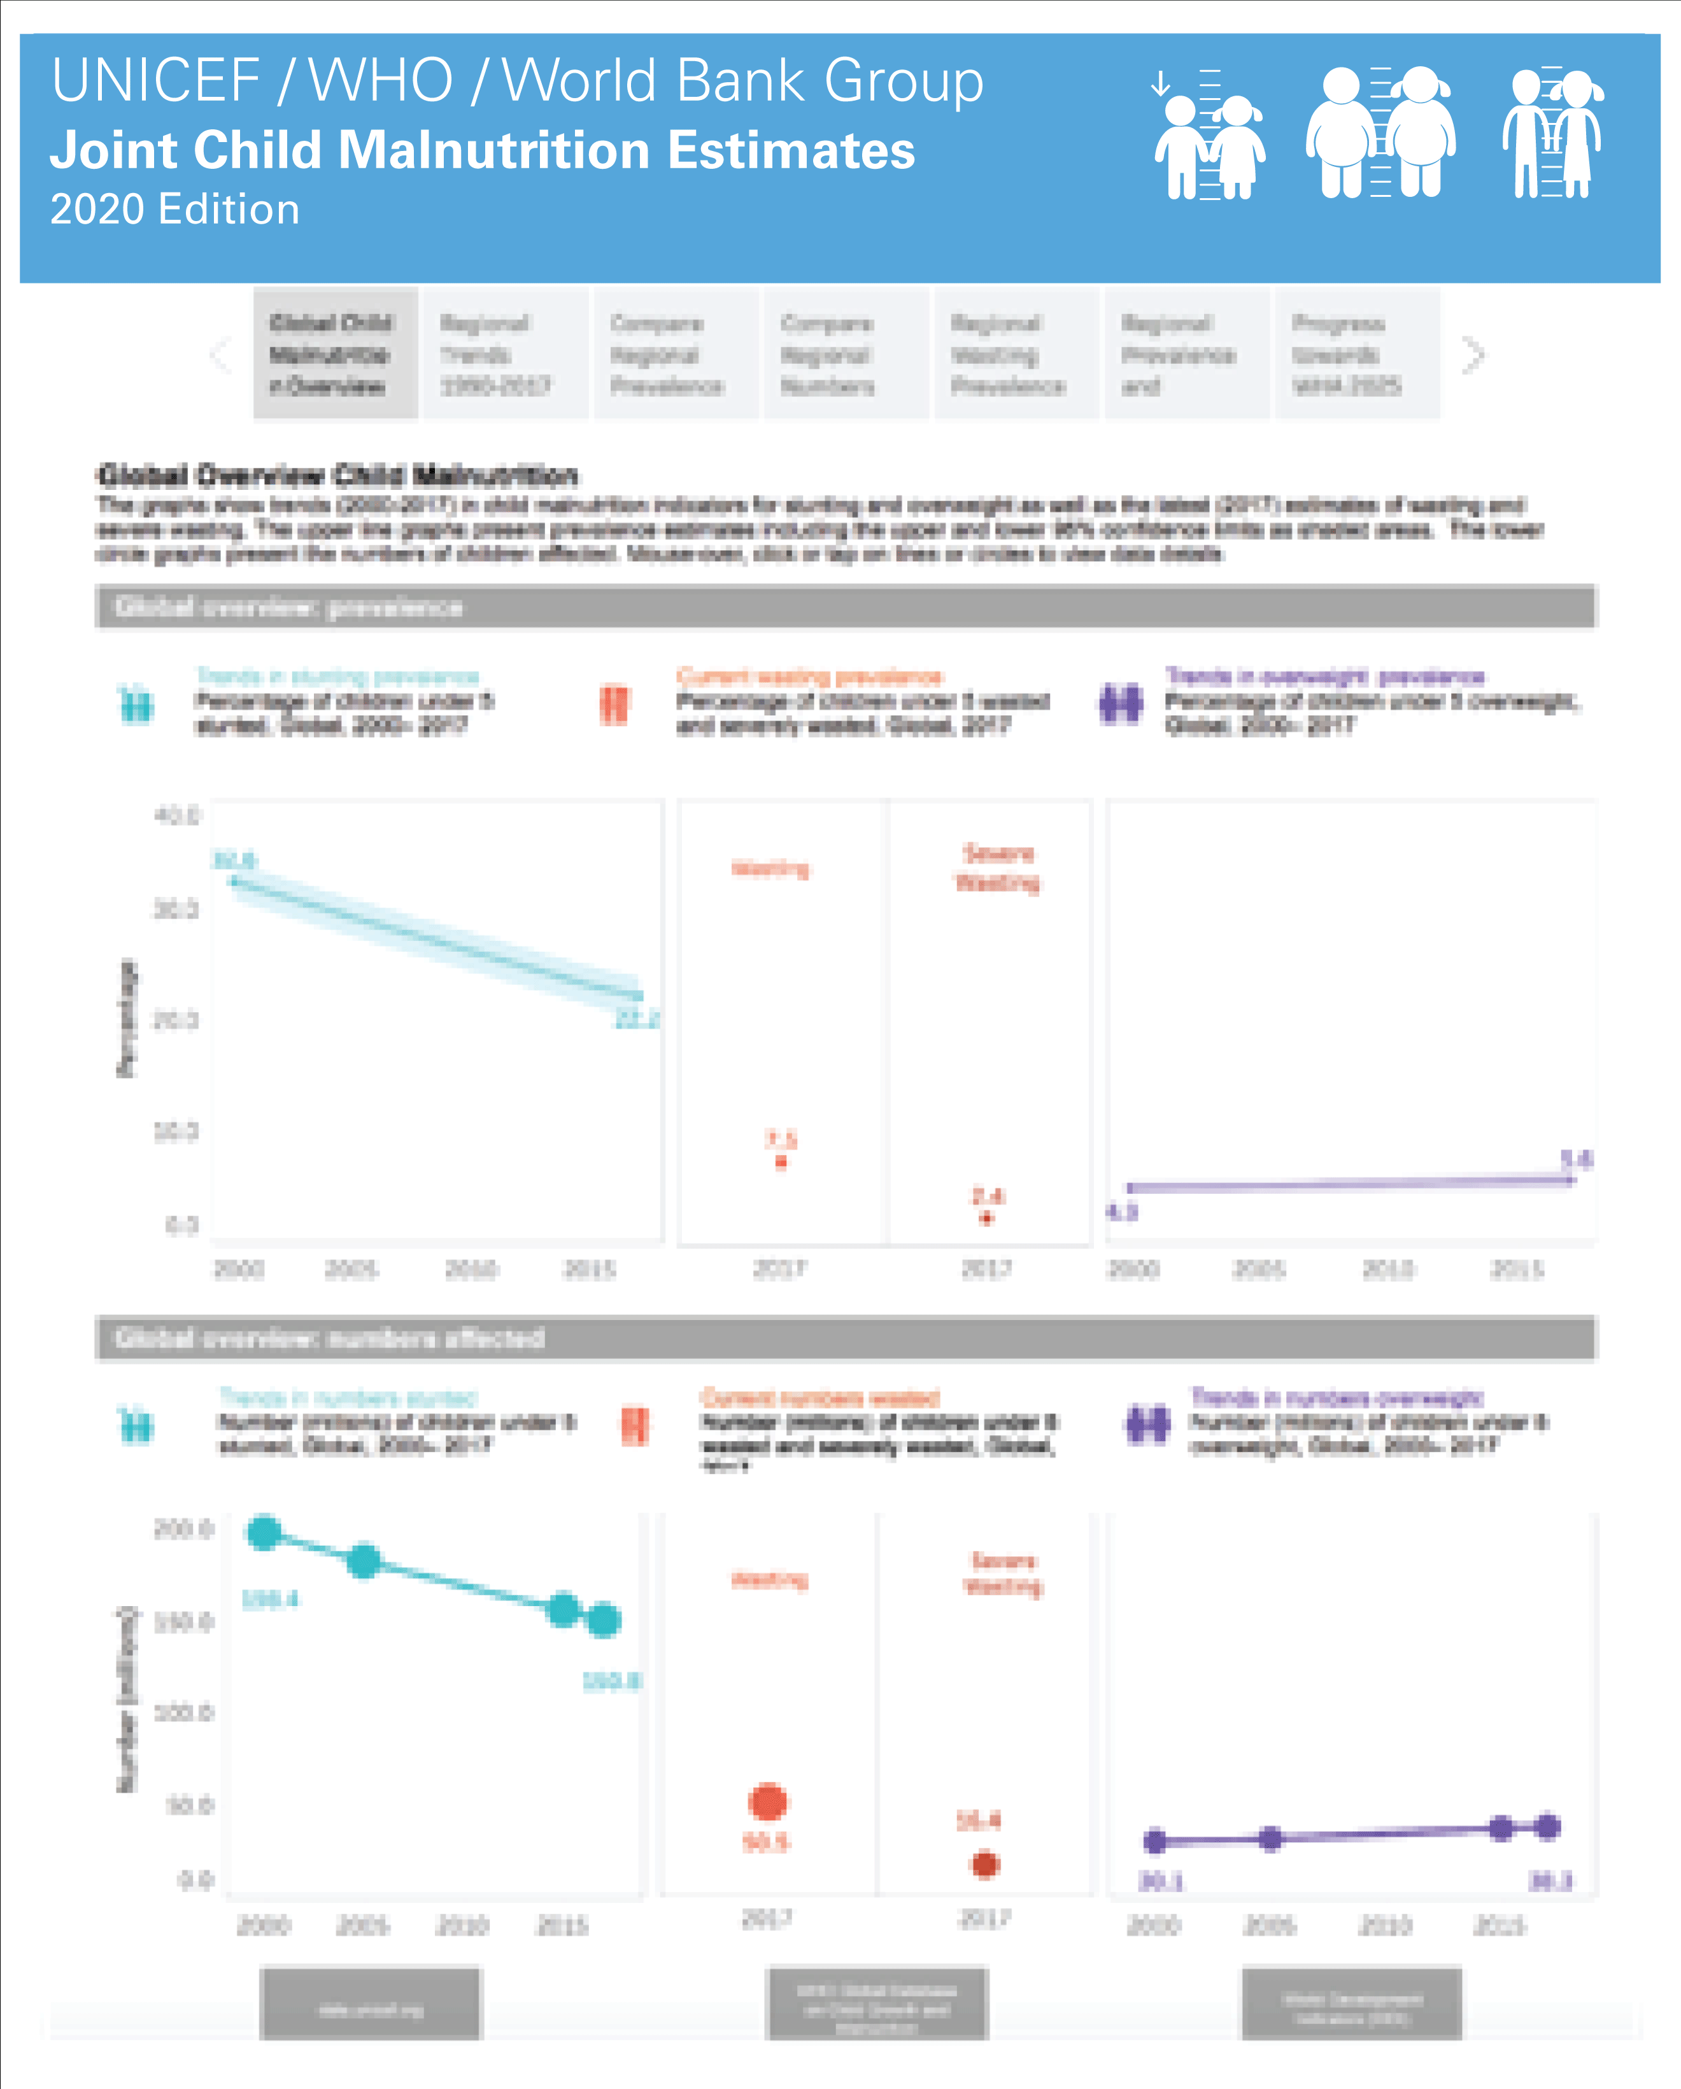
ONLINE MATERIALS
Interactive Dashboards
Interactive dashboards, which allow users to visualize and
export the global and regional estimates for a number of
regional groupings.
Available at: https://data.unicef.org/resources/joint-child-malnutrition-estimates-interactive-dashboard/

Slide 33
Prepared by:
Data and Analytics Section
Division of Data, Analytics, Planning & Monitoring
UNICEF Headquarters
3 UN Plaza, New York, NY, 10017
data.unicef.org
For more information contact:
data@unicef.org

